Slide 1

Marine mammal protection act
By Harrison Hee
4/22/20

Slide 2
Background
Written in 1972 due to concern over destruction of marine animal populations
First federal legislation that mandated an ecosystem-based approach to marine resource management
Implemented by U.S. Fish and Wildlife Service, National Oceanic and Atmospheric Administration Fisheries, and Marine Mammal Commission
Notes:
1972 also introduced the Clean Water Act
Three federal entities: USFWS, NOAA, and MMC

Slide 3
Marine mammal protection act (MMPA)
“A national policy to prevent marine mammal species and population stocks from declining beyond the point where they ceased to be significant functioning elements of the ecosystems of which they are a part.”
Cannot “take” marine mammals without take permits that are given out under specific exceptions
Goal is to prevent marine mammals from depleting to unsustainable levels AND restore small populations to optimum sustainable sizes
Created a single federally run program for marine mammal conservation

Slide 4
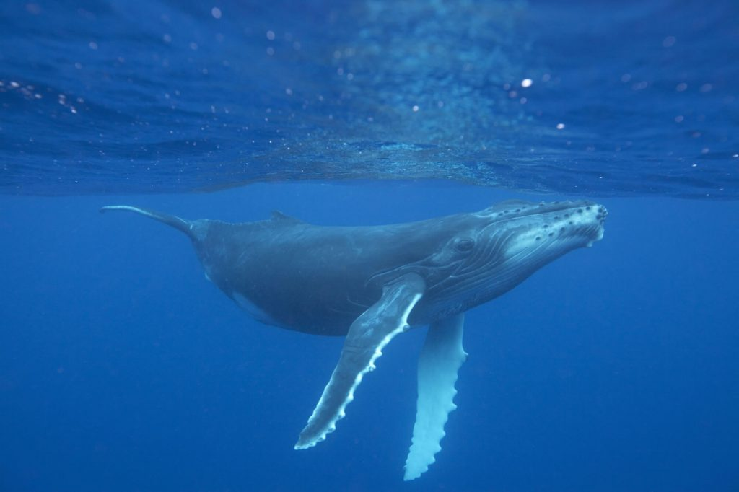
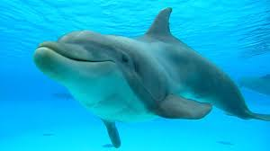
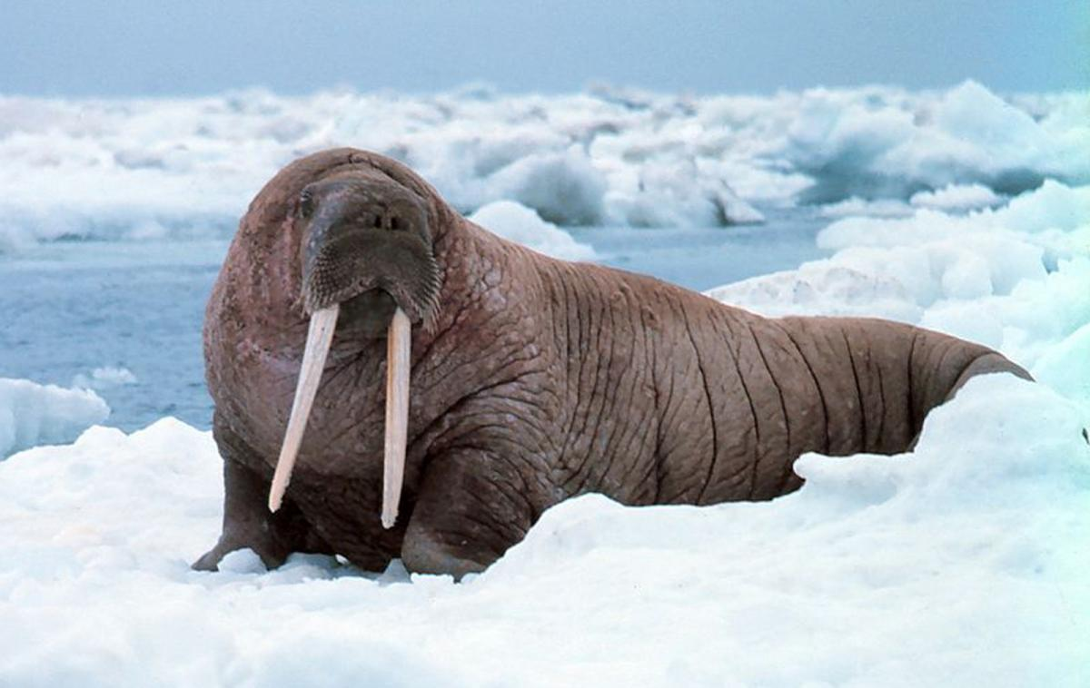
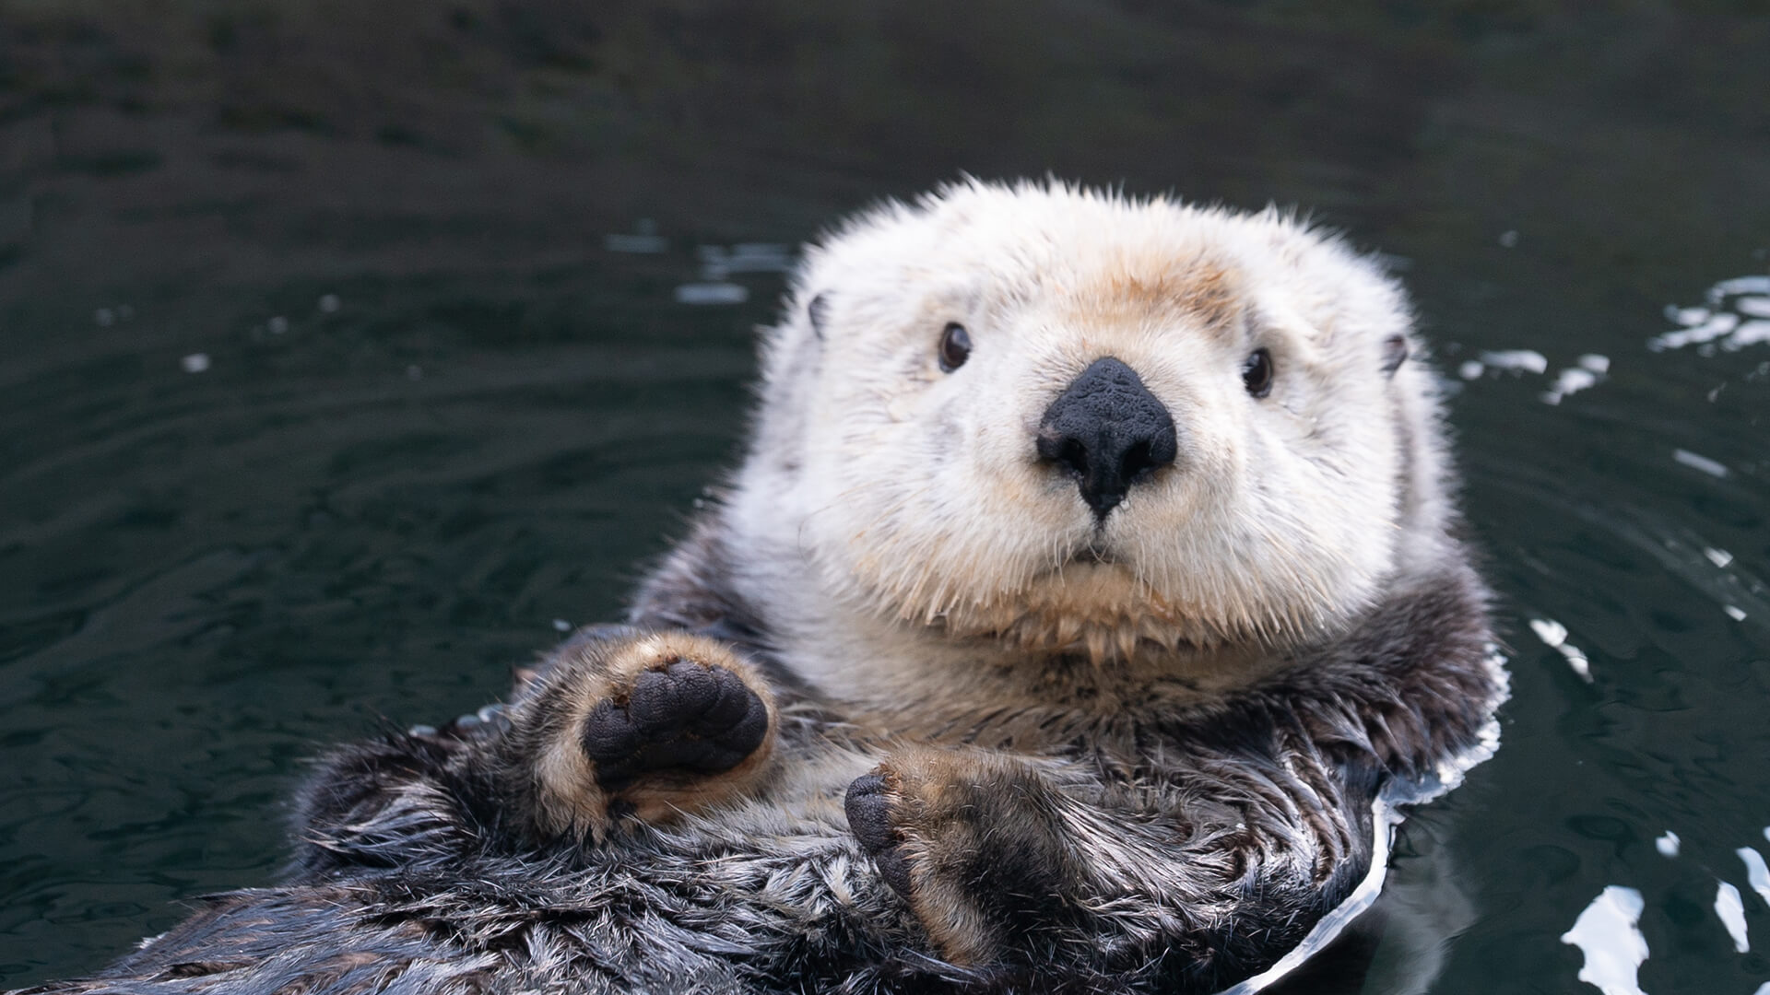
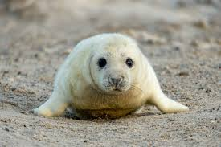
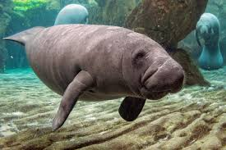
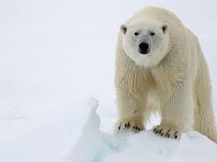
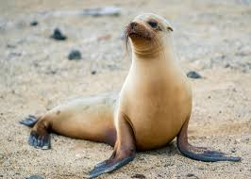
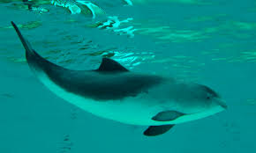
USFWs Species vs NOAAF Species
USFWS
NOAA
Notes:
Marine mammal species protection is divided between the U.S. Fish and Wildlife Service and the National Oceanic and Atmospheric Association.

Slide 5
Definitions
Marine Mammal: Any mammal which is morphologically adapted to the marine environment or primarily inhabits the marine environment
Marine Mammal Product: Any item of merchandise which consists, or is composed in whole or in part, of any marine mammal
“Take”: The act of hunting, killing, capture, and/or harassment of any marine mammal; or, the attempt at such
Harassment: Any act of pursuit, torment, or annoyance
Alaska Native Organization: A group designated by law or formally chartered which represents or consists of Indians, Aleuts, or Eskimos residing in Alaska

Slide 6
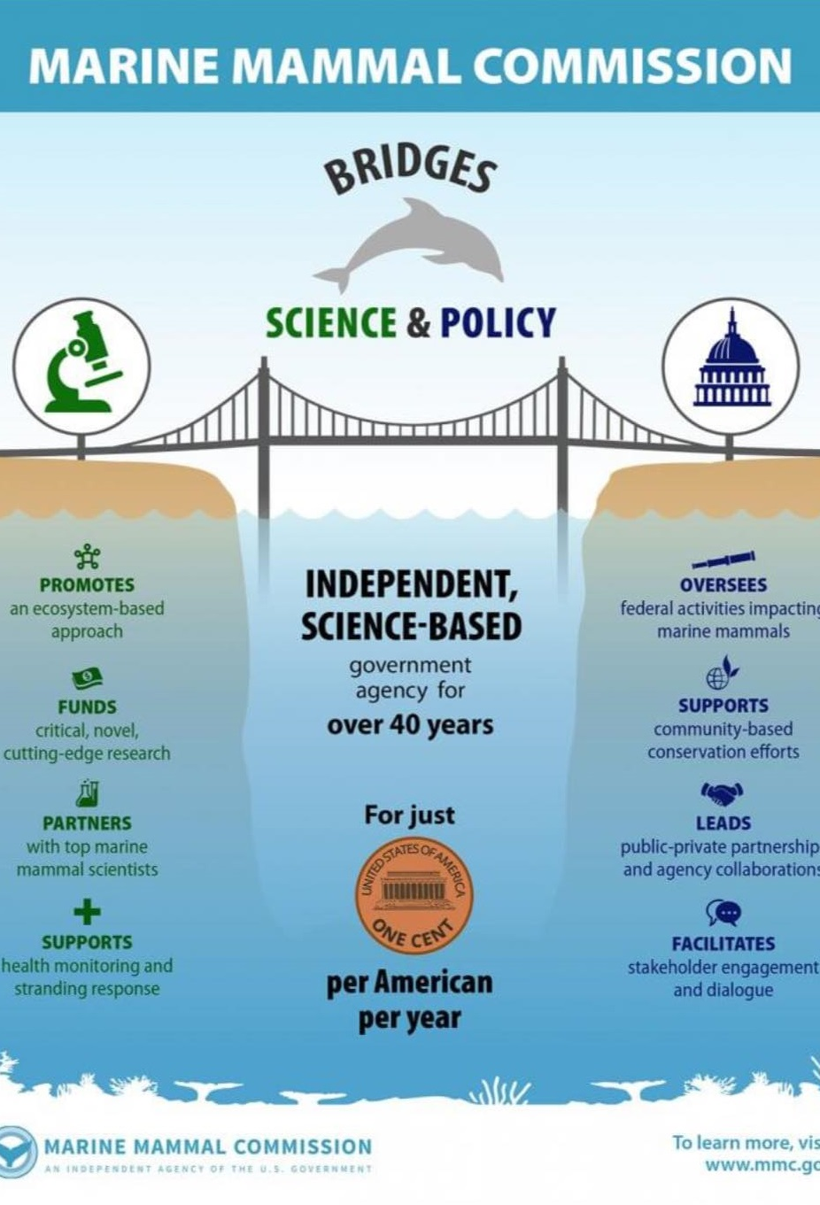
Marine Mammal commission
Only U.S. government agency that provides comprehensive oversight of all science, policy, and management actions affecting marine mammals
Made up of a nine-member committee and 14 employees
Reviews permit and incidental take authorization applications, proposed regulations, NEPA documents, and Endangered Species Act listing proposals
Develops and reviews marine mammal policy and guidance documents
Reviews research of marine mammals
E-mail: mmc@mmc.gov
Phone: 301-504-0099

Slide 7
Take permits
U.S. Fish and Wildlife Service can issue take permits for exceptions under the MMPA
Exceptions include:
Pre-MMPA specimens taken before December 21, 1972
International agreements entered into by the United States before December 21, 1972
Alaska natives (1995 amendment)
Scientific research, public display, enhancing the survival or recovery of a species, and incidental take in commercial fisheries
Waivers granted by the U.S. government

Slide 8
Alaska natives
Marine mammals used for subsistence, crafts, trade, and sale
Only natives with 1/4th blood quantum or more can intentionally take marine mammals under the MMPA
A study in October 2016 pointed out that constantly diminishing Native Alaskan blood quantum will lead to increasingly greater restraints on how many villages will be able to take marine mammals in the future
In the Gulf of Alaska region, 56-59 percent of recorded populations had a blood quantum of 1/4th or less

Slide 9
Incidental take authorization
Military sonar and training exercises
Oil and gas development, exploration, and production
Other energy activities
Scientific research
Construction projects
For unintentional take of marine mammals, typically involving disturbance of habitat of involved species
Eligible if taking involves small numbers of marine mammals, have no more than negligible impact on species and stocks, and not have an unmitigable adverse impact on the availability of species or stocks for subsistence use
Notes:
Intentional take is rarely ever authorized, and if authorized is typically for subsistence use for small tribes

Slide 10
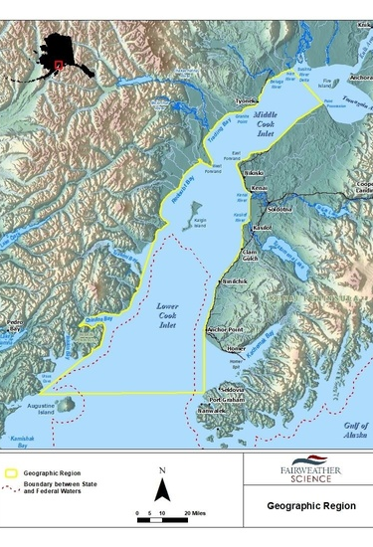
Example: hilcorp Alaska LLC Oil and gas activities in cook inlet, Alaska
Affects:
Beluga whale
Dall’s porpoise
Gray whale
Harbor porpoise
Harbor seal
Humpback whale
Killer whale
Minke whale
Stellar sea lion
Notes:
Effective July 30, 2019, this incidental take authorization includes a notice of modified letter of authorization (LOA), notice of request for LOA modification, final rule, proposed rule, and notice of receipt of application for LOA in the federal register. Also available for public viewing are FONSI, marine mammal monitoring and mitigation plan, final environmental assessment, and public comments.

Slide 11
Stock assessment Reports
16 U.S.C. 1386
Sec. 117. (a) IN GENERAL. — Not later than August 1, 1994, the Secretary shall, in consultation with the appropriate regional scientific review group established under subsection (d), prepare a draft stock assessment for each marine mammal stock which occurs in waters under the jurisdiction of the United States.
An amendment added in 1994 that requires the U.S. Fish and Wildlife Service to periodically report on the status of marine mammal stocks in U.S. waters
Each stock assessment report requires a description of the stock’s geographic range, a minimum population estimate, current population trends, current and maximum net productivity rates,

Slide 12
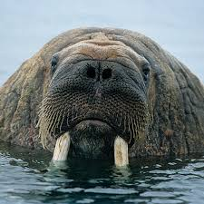
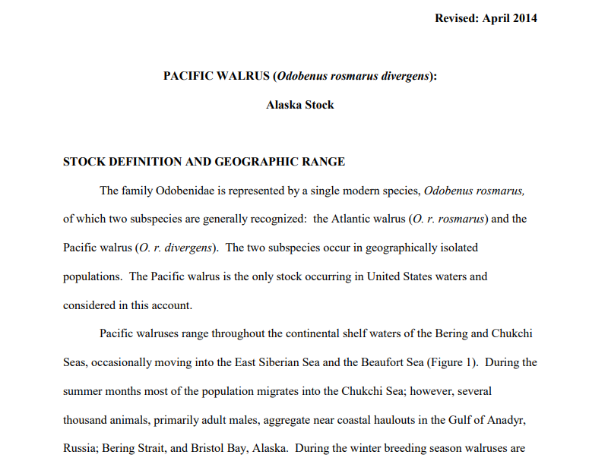
Example: Pacific Walrus – Alaska Stock (April 2014)
Range: Continental shelf waters of the Bering and Chukchi Seas
Minimum Population Size: 129,000
Current Population Trend: Not precise as data is biased low, but it is currently below carrying capacity

Slide 13
Alaskan Natives
Sec. 119. (a) IN GENERAL. — The Secretary may enter into cooperative agreements with Alaska Native organizations to conserve marine mammals and provide co-management of subsistence use by Alaska Natives.
Agreements include developing marine mammal on-management structures and processes with Federal and State agencies, monitoring the harvest of marine mammals for subsistence use, participating in marine mammal research, and collecting and analyzing data on marine mammal populations

Slide 14
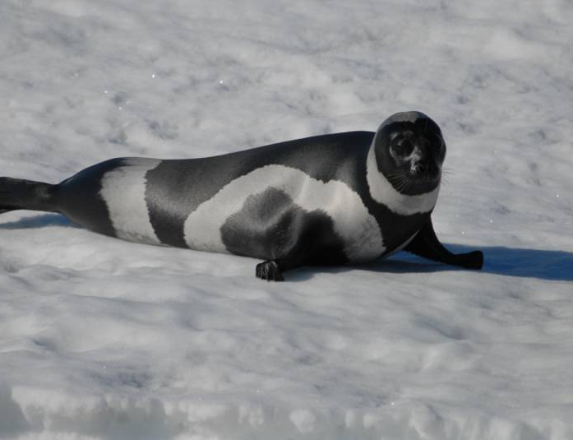
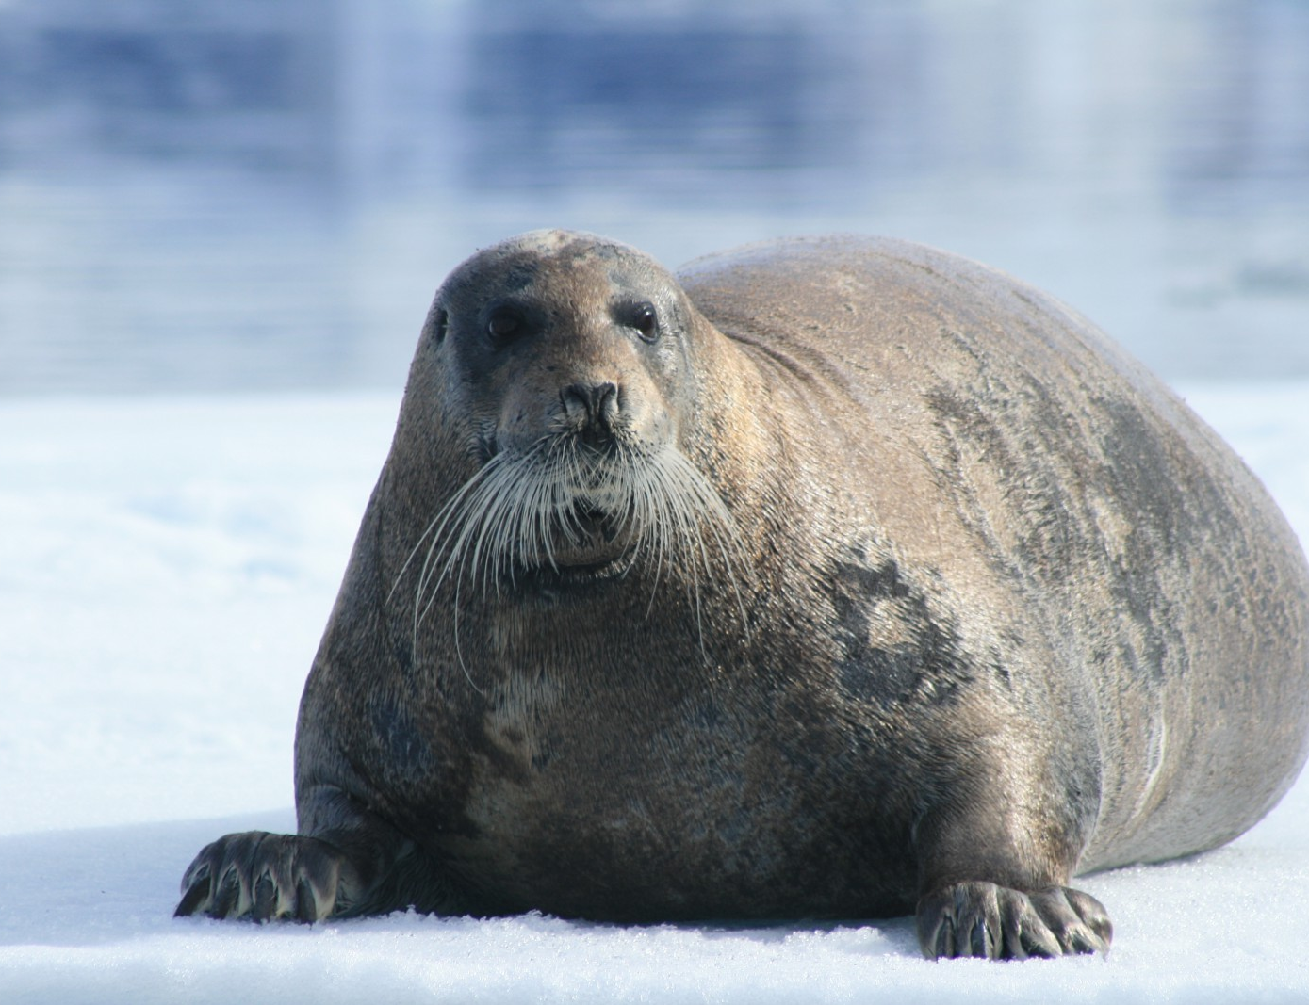
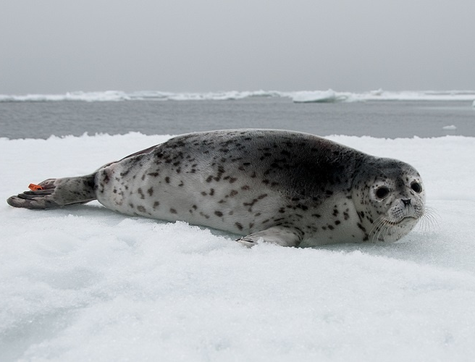
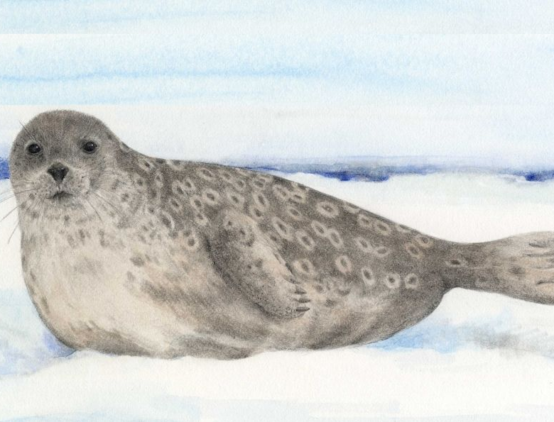
Example: Ice seal committee agreement
Parties – Ice Seal Committee and National Marine Fisheries Service
Purposes – Set forth a structure for the conservation and management of ice seals in Alaska
Scope – Covers the ringed seal, bearded seal, ribbon seal, and spotted seal
Notes:
7 page document signed in 2006 that outline parties, purposes, guiding principles, authorities, scope, operational structure, management plan, consultations, funding, other provisions, and signatories

Slide 15
Penalties
Violations for hunting and killing may result in fines up to $100,00 and a year of imprisonment for individuals and up to $200,000 for organizations
Harassment violations include civil penalties of up to $11,000 and a year of imprisonment and penalties for vessels of up to $25,000
For one case, a Panama City boat rental company was fined $4,500 for simply feeding dolphins
In another case, a fisherman found a dead dolphin in his gil net and simply discarded the body back into the ocean where it was reported by a passerby and found by the NOAA and DNR
Notes:
Another case involved a Californian woman pleading guilty to feeding whales in a marine sanctuary, although details on penalties is rather limited. Another source claimed a penalty of $20,000 for an intentional violation and $10,000 for an unintentional violation so the numbers must have changed over time.
In the dolphin case, the fine was initially $6,500 (with a 10% discount if paid in 30 days), but was argued in a civil case. It was determined in the hearing that the fisherman did not partake in lethal taking and the case was dropped, but it was estimated that it cost the fisherman as much as $35,000 for legal fees.

Slide 16
Summary
MMPA protections marine mammals from take
Drafted due to concerns of constantly depleting populations of marine mammals in fragile ecosystems
Take is the act of killing, hunting, capture, and/or harassment of any marine mammal; or, the attempt at such
Nine different types of marine mammals protected, some already covered under the ESA
Take permits authorized for specific intentional exceptions, including subsistence use for Native Alaskans
Native Alaskans allowed to take under the MMPA is constantly decreasing over time
Incidental take authorization commonly given for unintentional, but not unexpected, minor take
Stock assessments periodically written to update status of species protected by the MMPA

Slide 17
Sources
https://www.mmc.gov/w
https://www.fws.gov/
https://www.fisheries.noaa.gov/topic/marine-mammal-protection
https://www.sealaskaheritage.org/node/361
http://www.ace.to/mmpa.html
https://www.bluetoad.com

