Slide 1
Floodplain Permits
Title 15 Building & Construction Standards
Floodplain Management Regulations
Ord. No. 71-9 adopted May 27, 1971

Slide 2
Table of Contents
Floodplain Permits
Zoning 101
Are Permits Required?

Slide 3
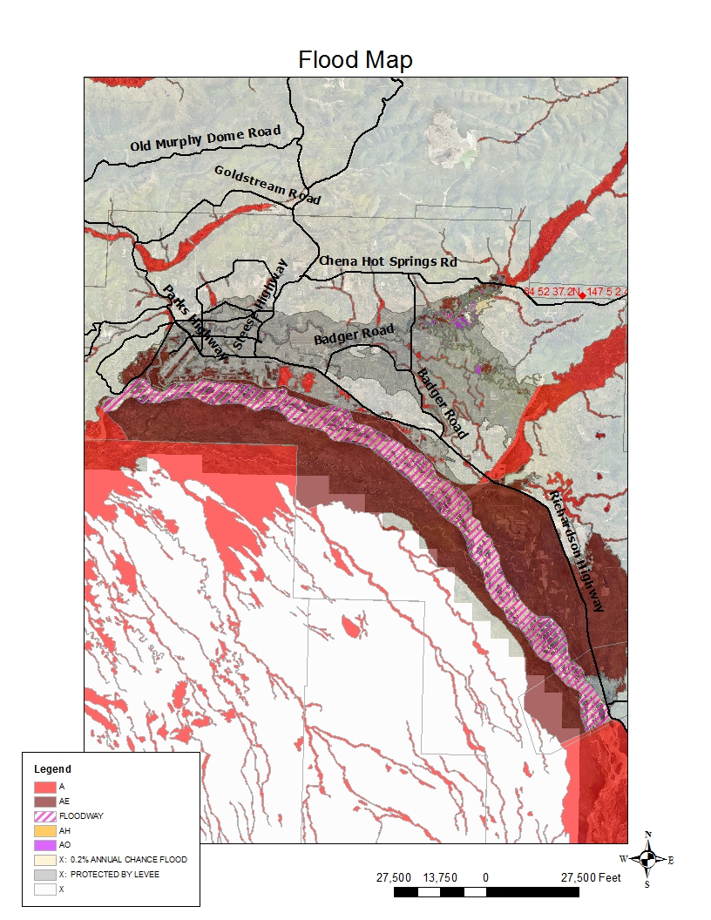
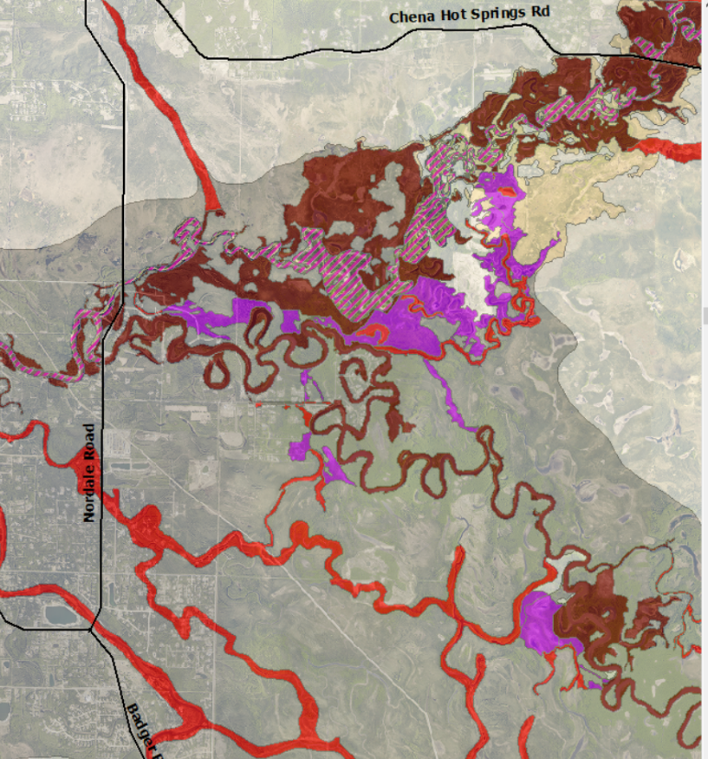
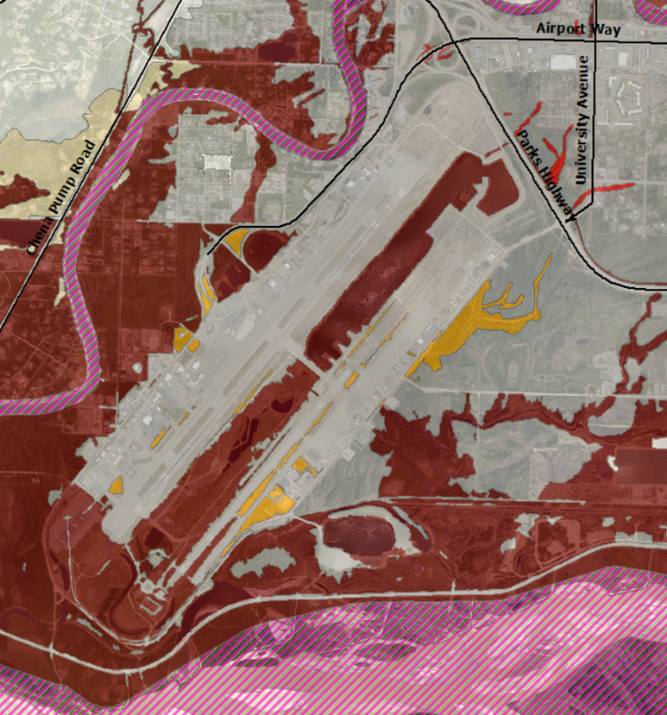

Slide 4
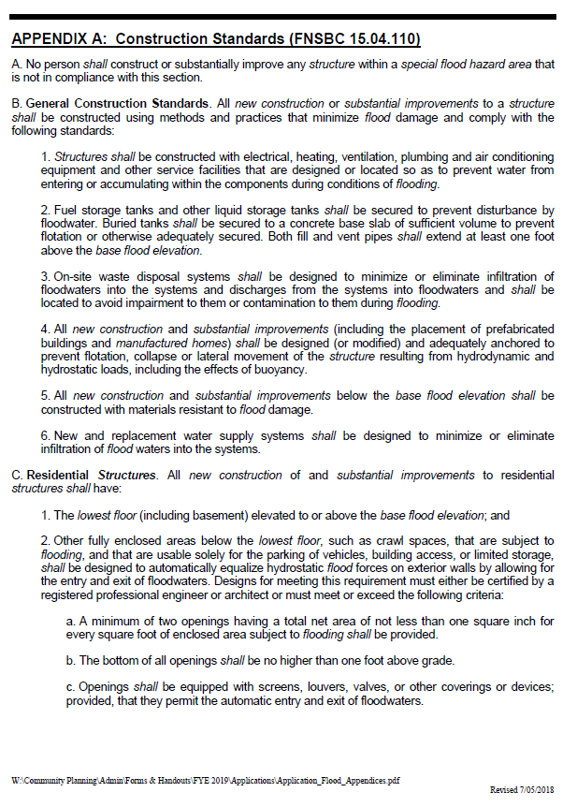
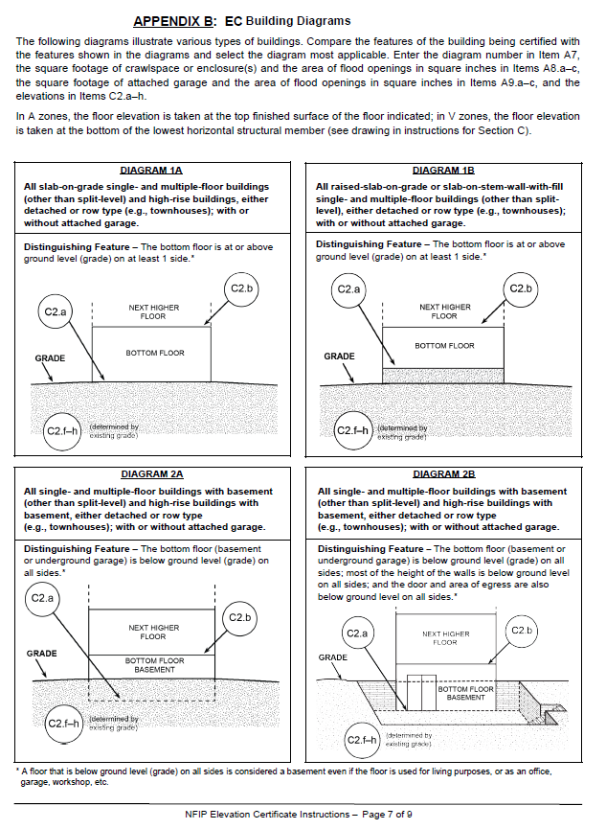
Appendices

Slide 5
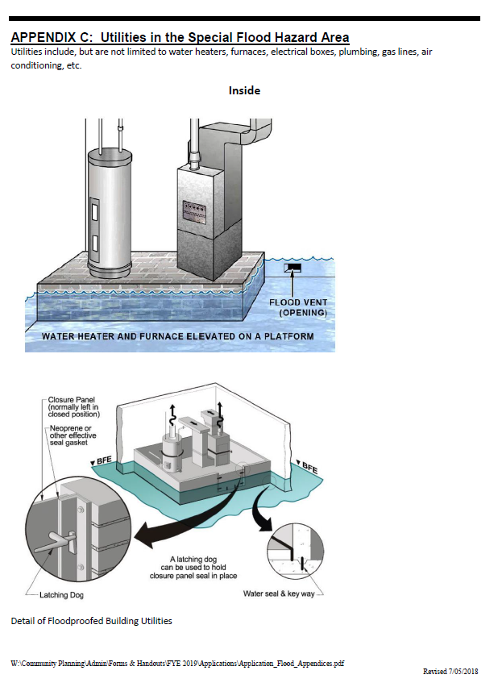
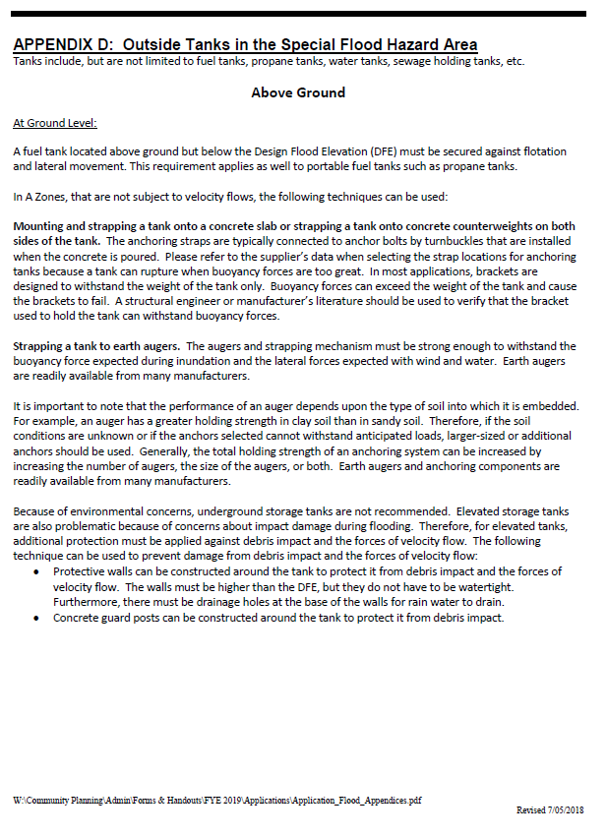
Appendices

Slide 6
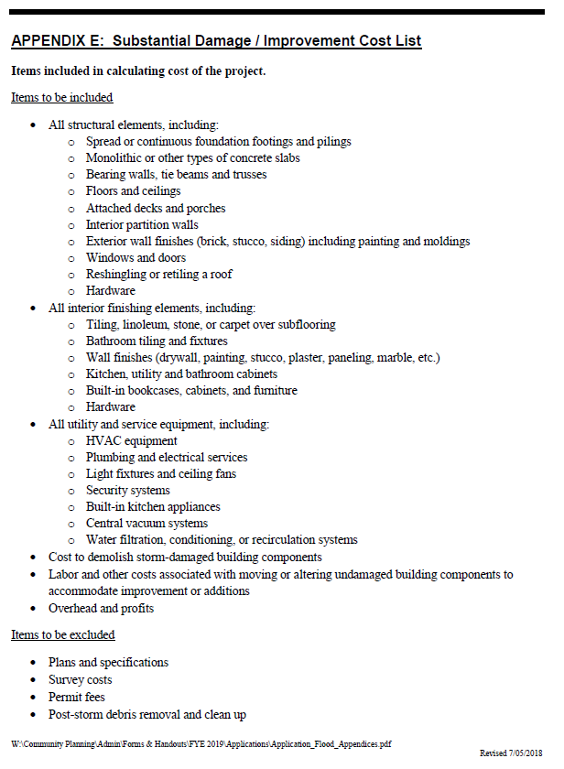
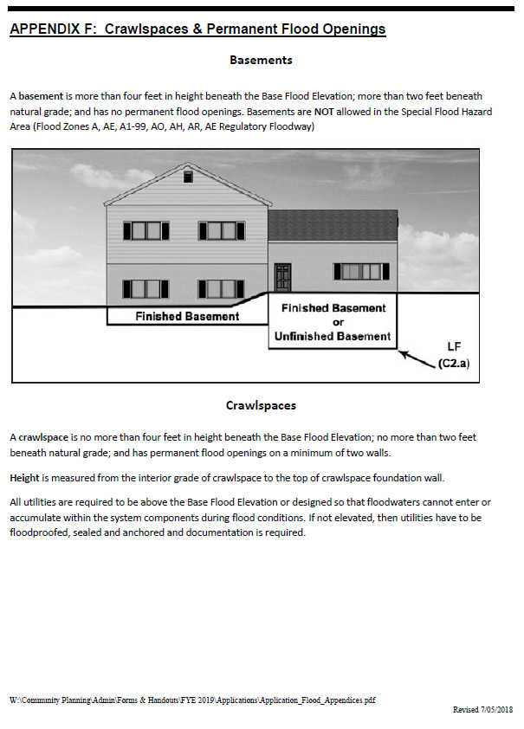
Appendices

Slide 7
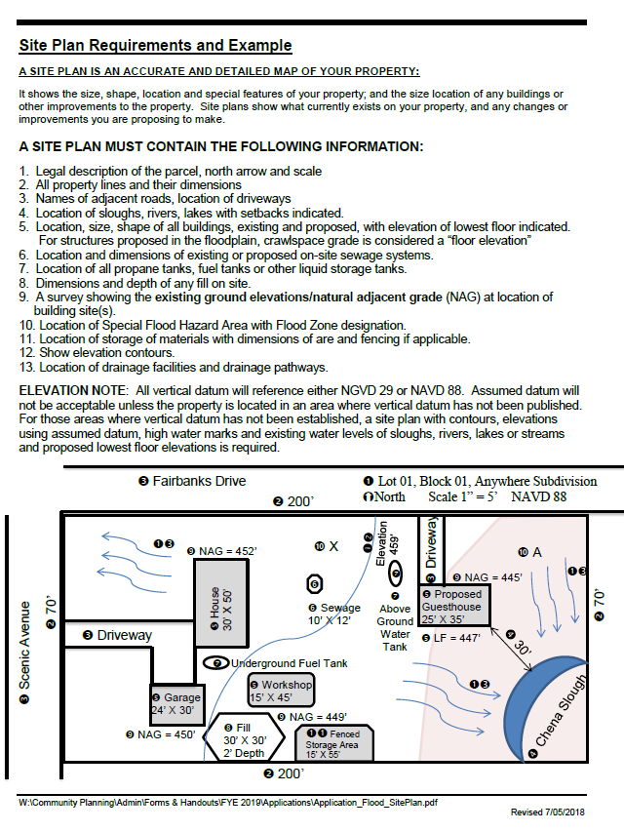
Site Plan Diagram
Requirements and an example of how an individual property diagram should be completed.

Slide 8
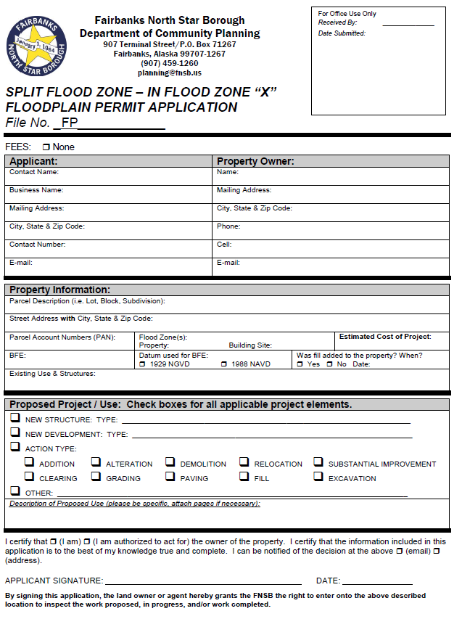
Split Flood Zone – In Flood Zone “X”
Easiest application.
Properties with split flood zones.
For development in a “X” type flood zone only.
Complete 2-page application.
Submit detailed site plan.

Slide 9
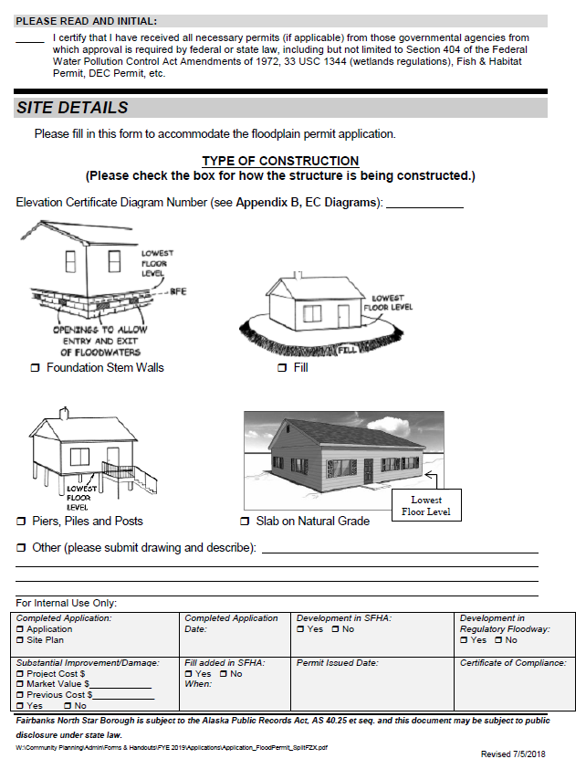
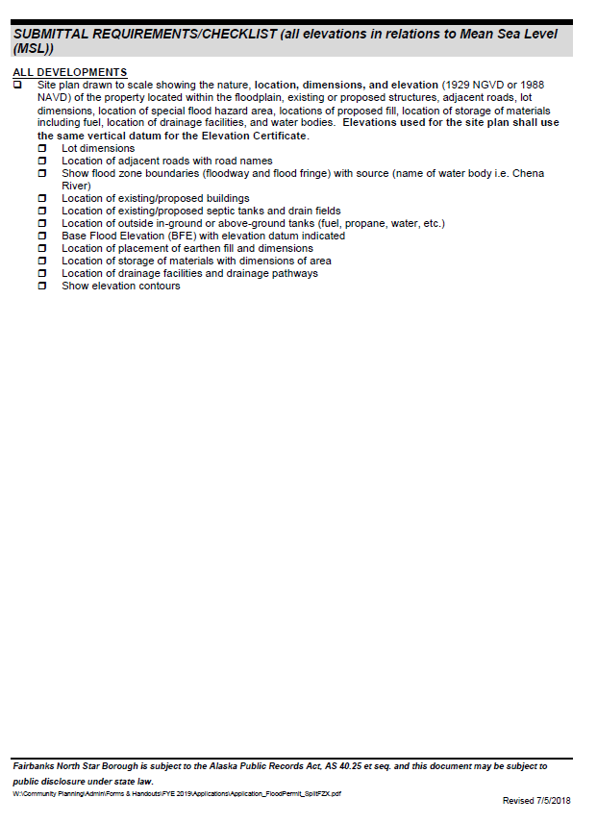
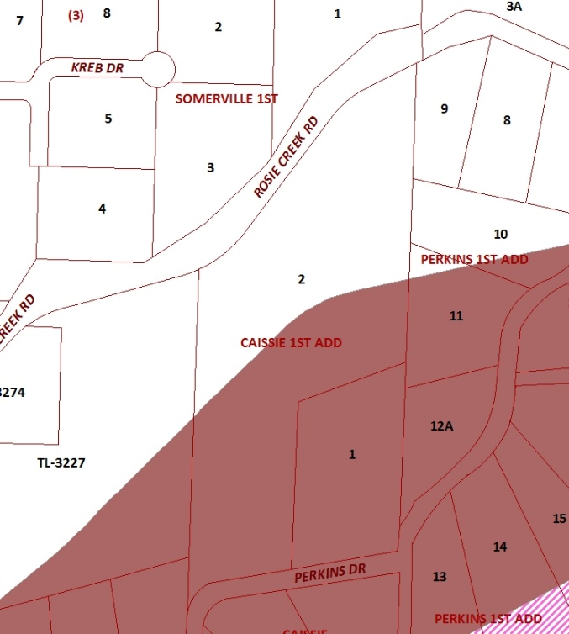
Split Flood Zone (cont.)

Slide 10
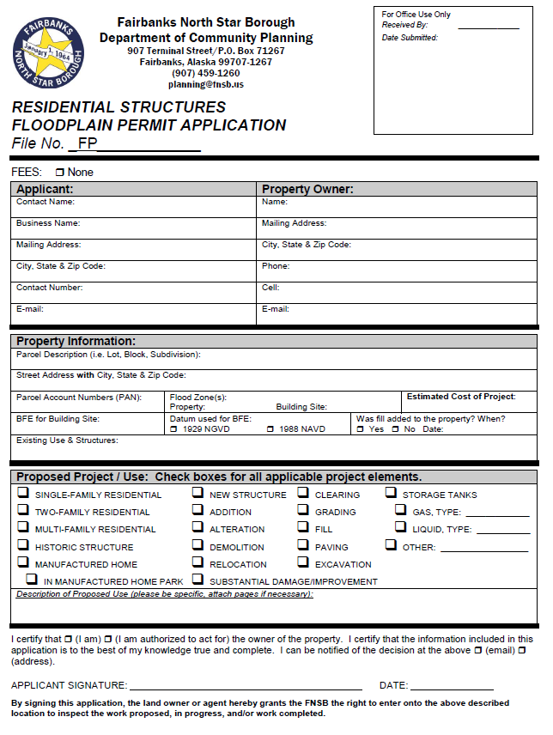
Residential Structures
For ALL residential structures.
Complete 4-page application.
Submit detailed site plan.
Submit other required documentation (3-page submittal instructions).
  Building plans.
  Copy of required permits.
  Detailed tank plans.
  Etc.

Slide 11
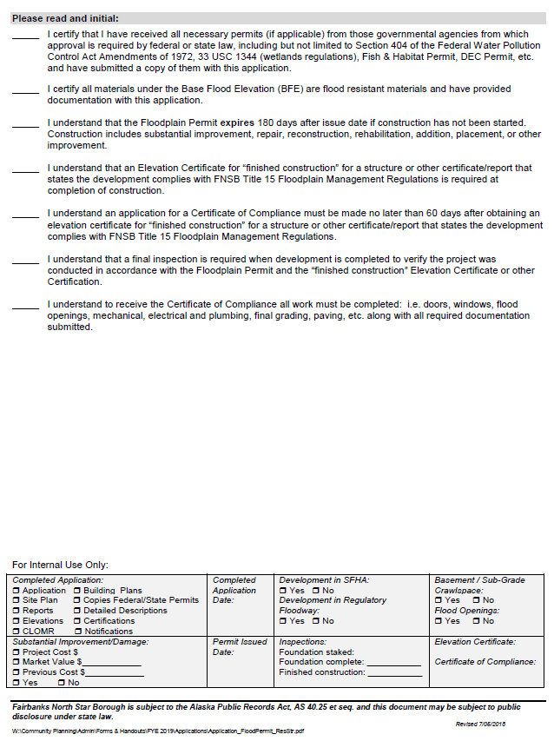
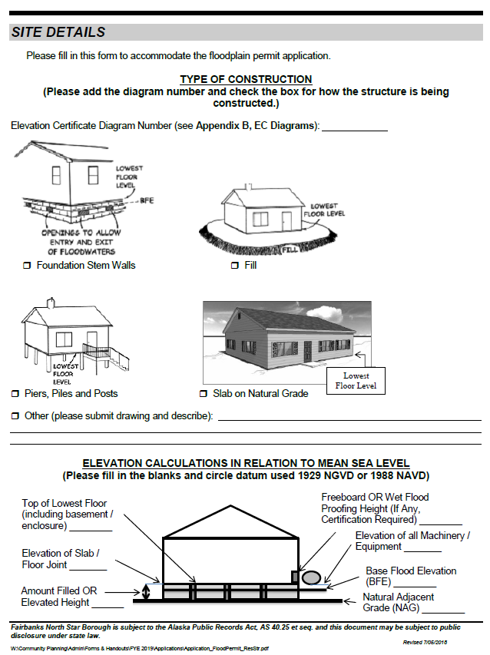
Residential Structures (cont.)

Slide 12

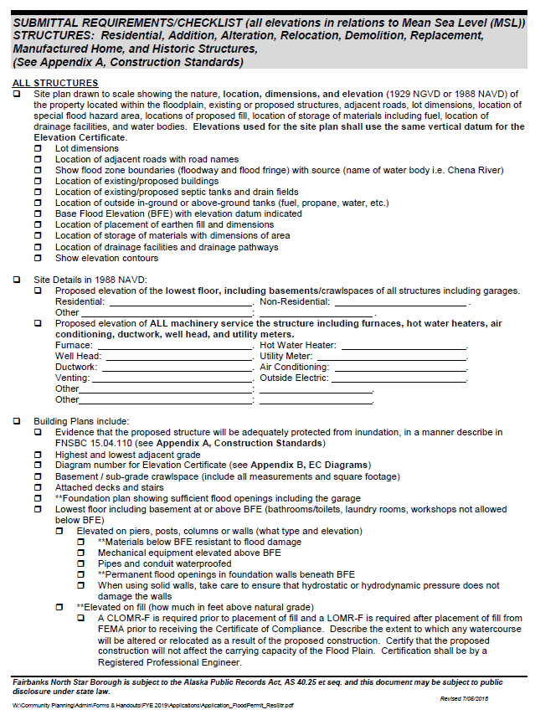
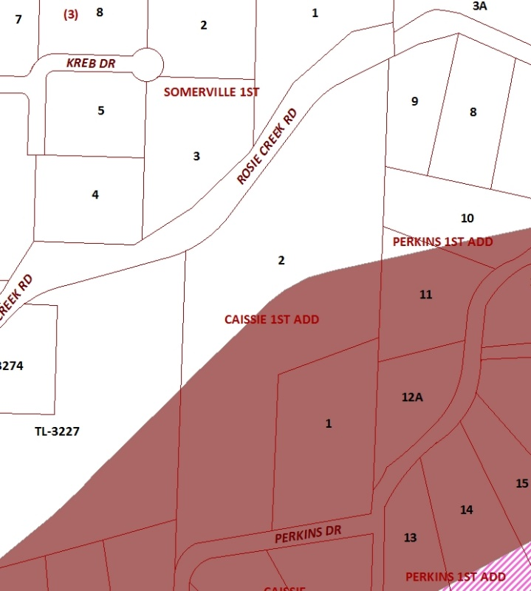
Residential Structures (cont.)

Slide 13
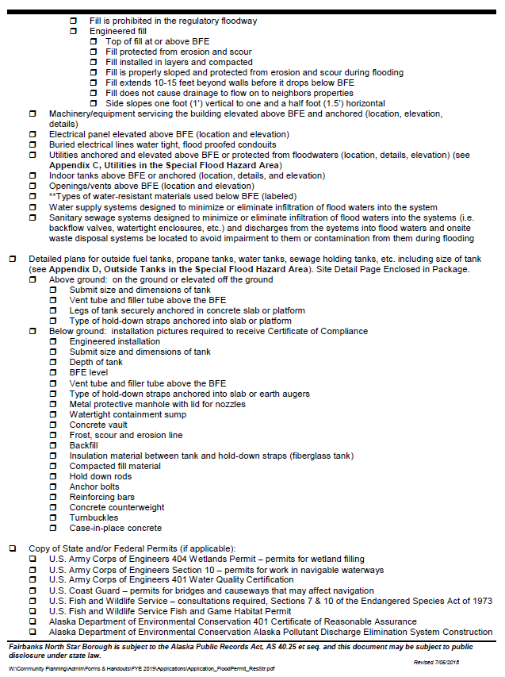
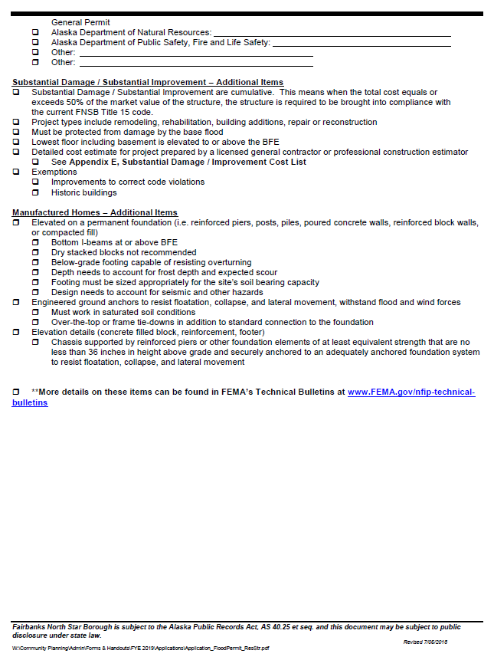
Residential Structures (cont.)

Slide 14
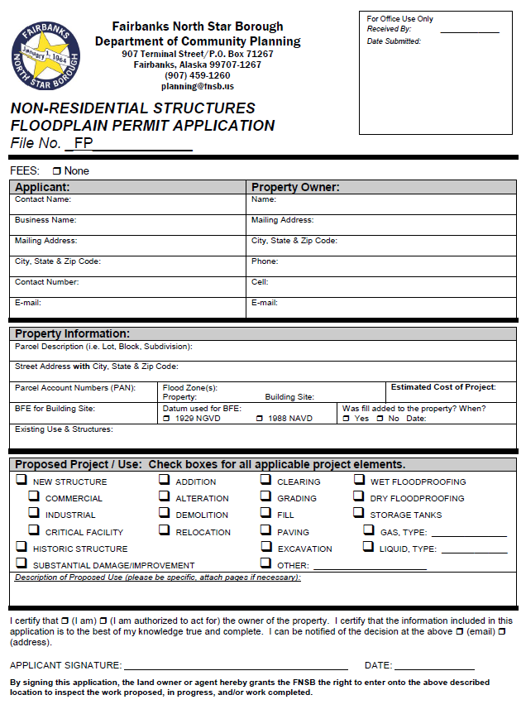
Non-Residential Structures
Only for non-residential structures.
Complete 4-page application.
Submit detailed site plan.
Submit other required documentation (3-page submittal instructions).
  Building plans.
  Copy of required permits.
  Detailed tank plans.
  Floodproofed Certification.
  Etc.

Slide 15
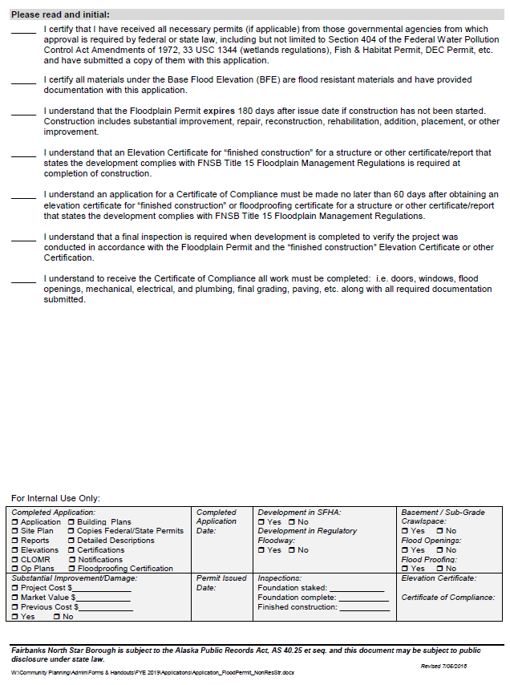
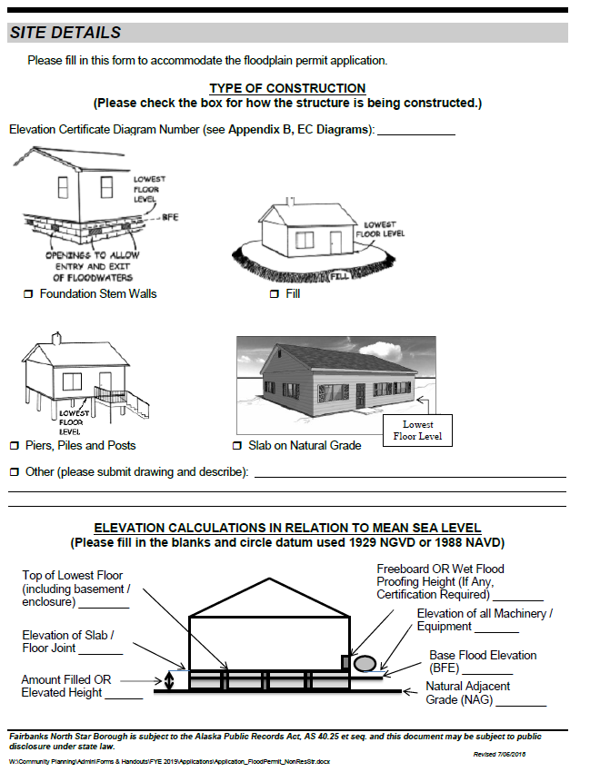
Non-Residential Structures (cont.)

Slide 16
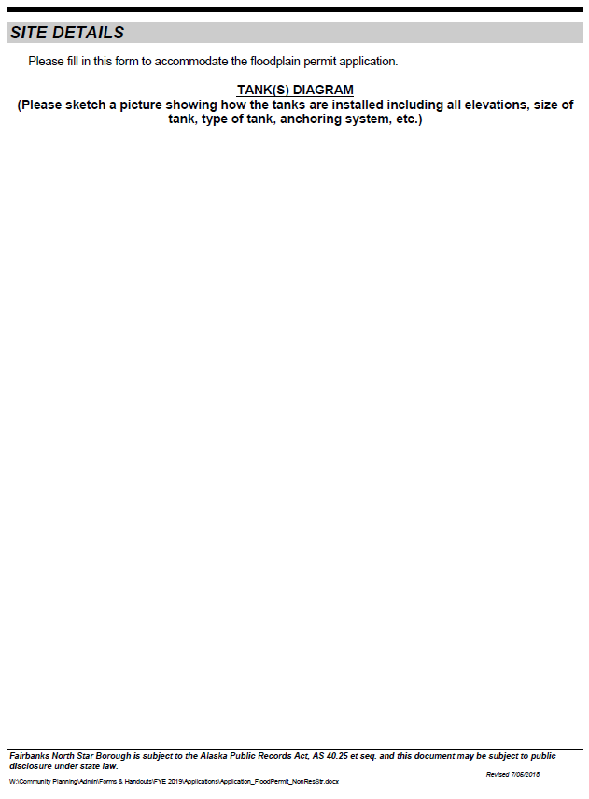
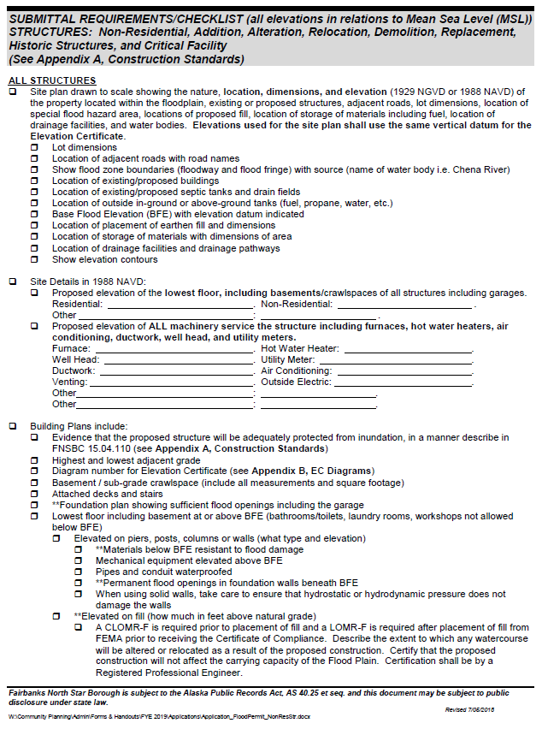
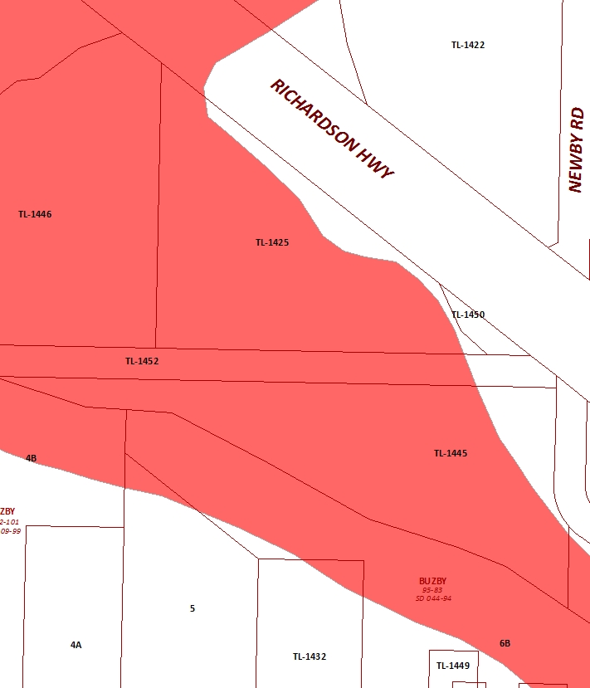
Non-Residential Structures (cont.)

Slide 17

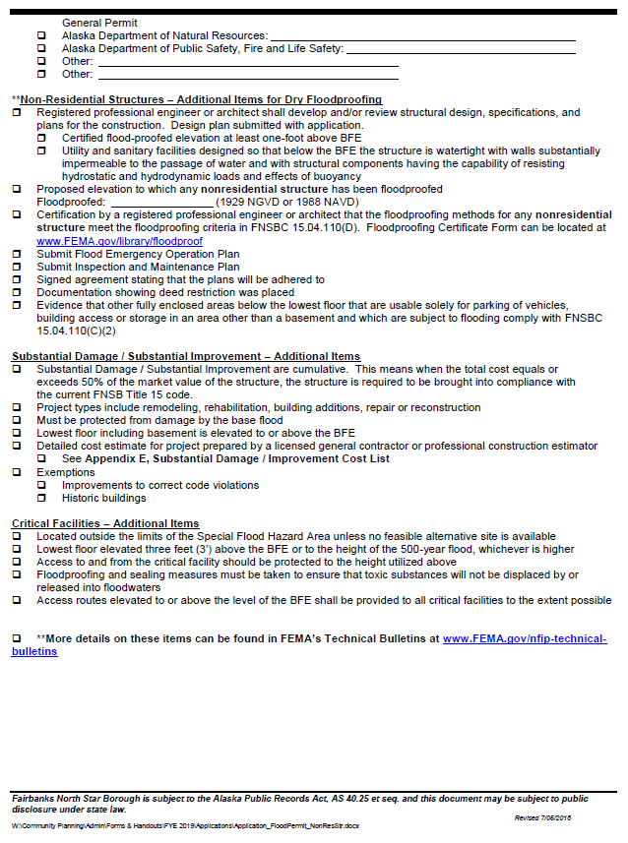
Non-Residential Structures (cont.)

Slide 18
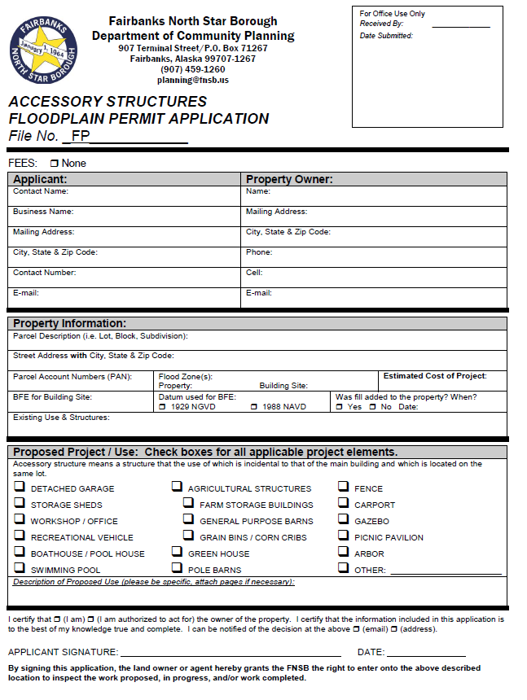
Accessory Structures
For accessory structures.
Complete 3-page application.
Submit detailed site plan.
Submit other required documentation (3-page submittal instructions).
  Building plans.
  Copy of required permits.
  Floodproofed Certification
  Flood Opening Details
  Etc.

Slide 19
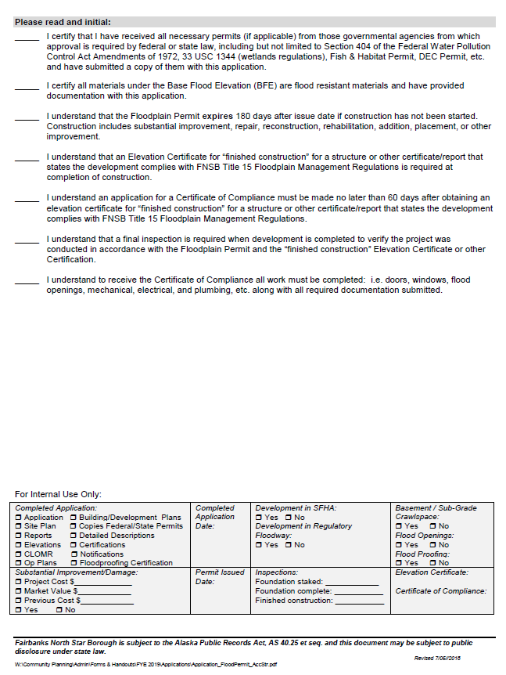
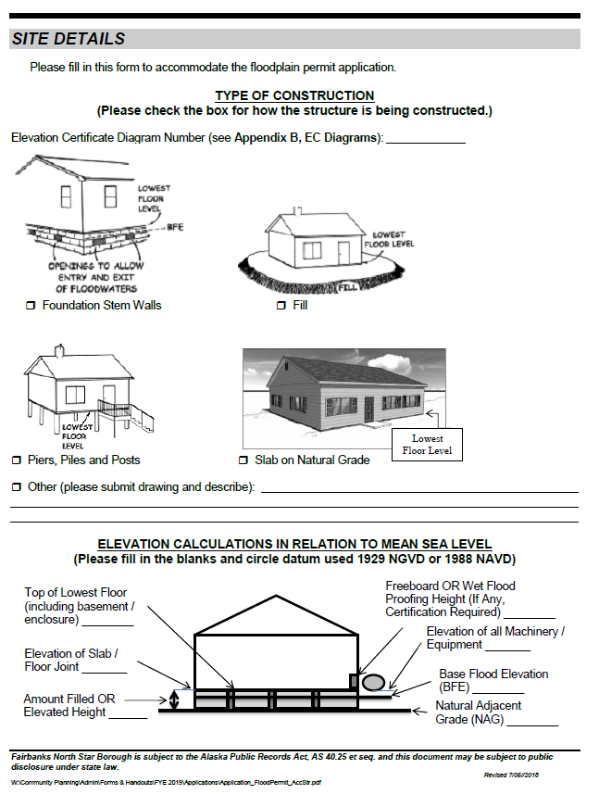
Accessory Structures (cont.)

Slide 20
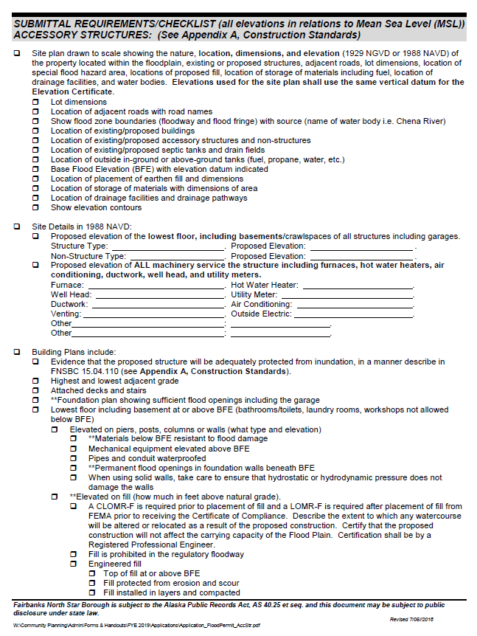
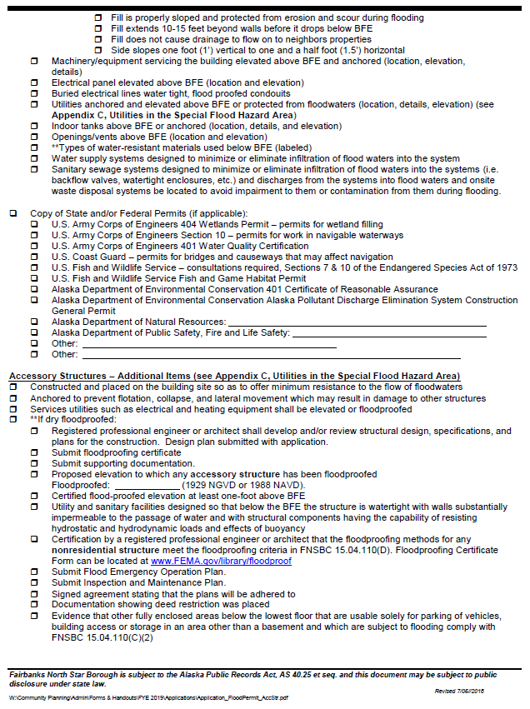
Accessory Structures (cont.)

Slide 21
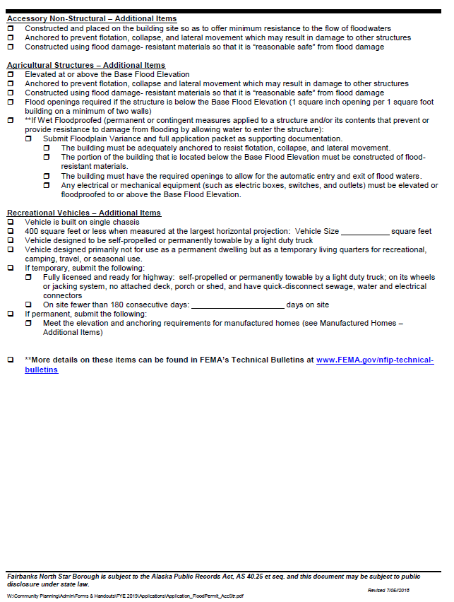
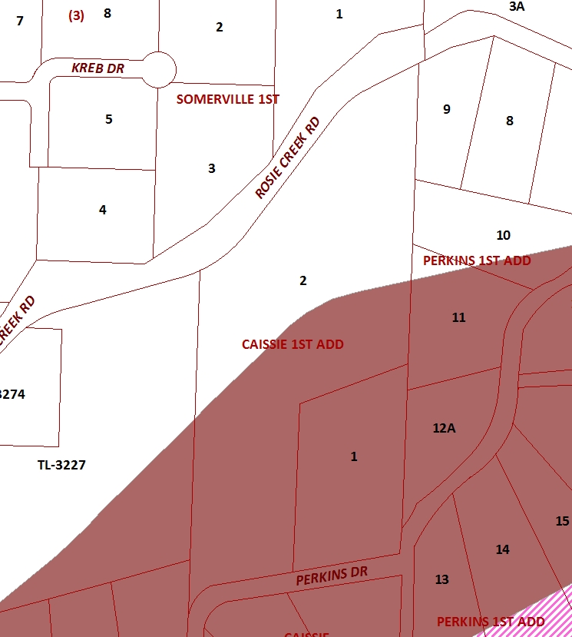
Accessory Structures (cont.)

Slide 22
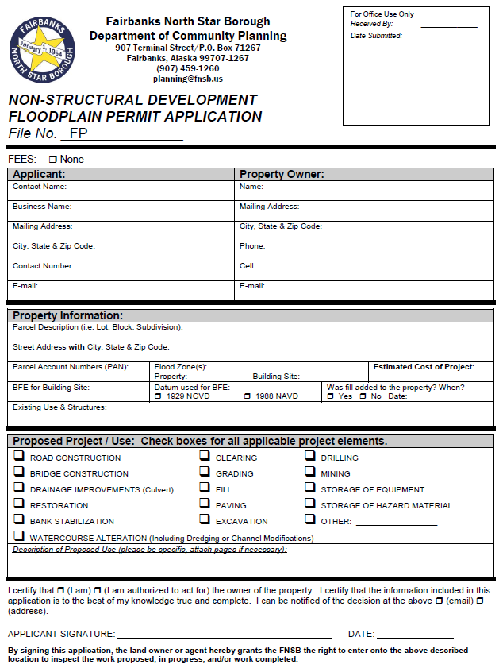
Non-Structural Development
For development that is not considered a structure.
Complete 2-page application.
Submit detailed site plan.
Submit other required documentation (3-page submittal instructions).
  Detailed plans.
  Copy of required permits.
  Written report.
  Etc.

Slide 23
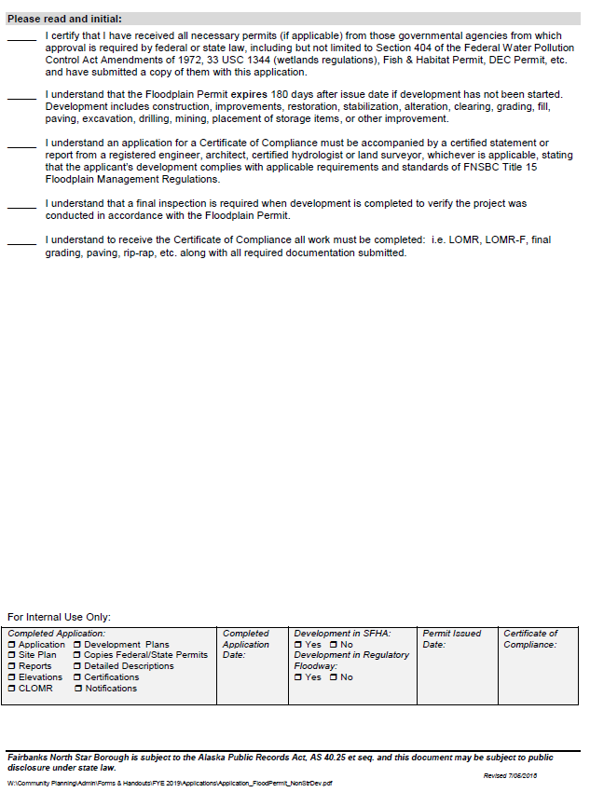
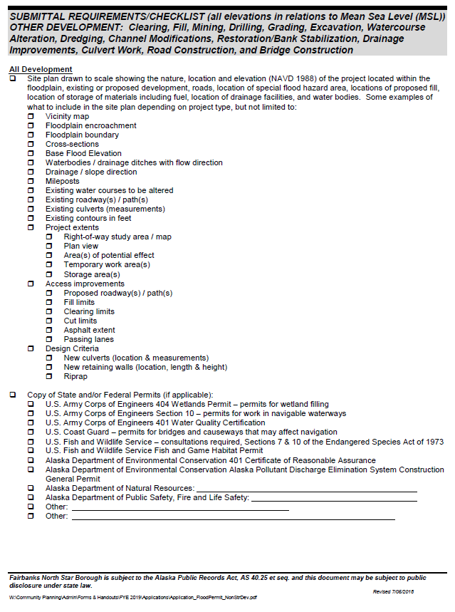
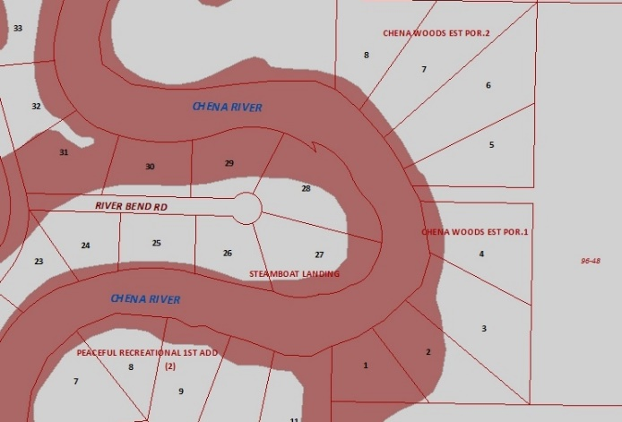
Non-Structural Development (cont.)

Slide 24
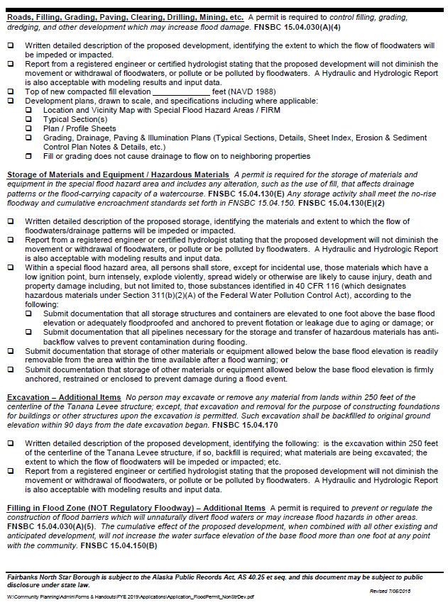
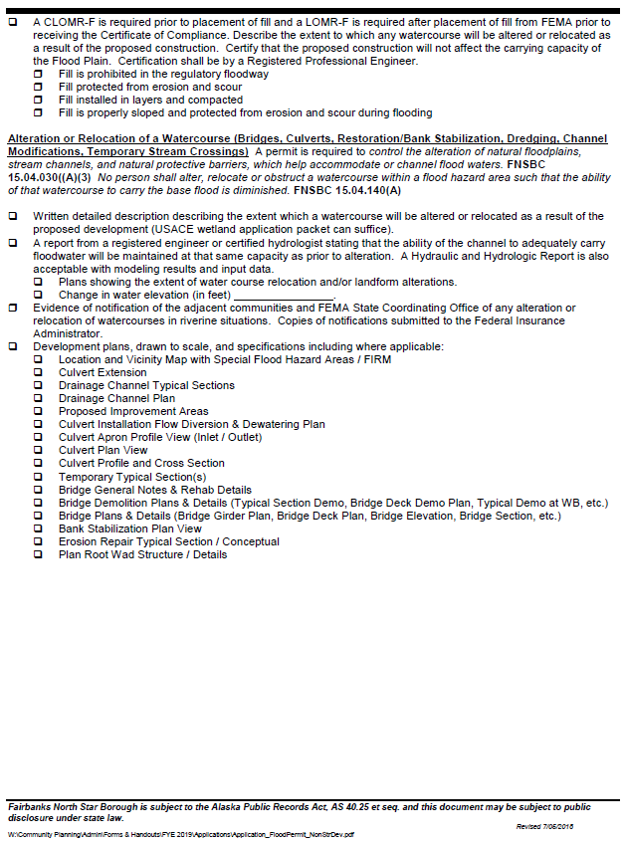
Non-Structural Development (cont.)

Slide 25
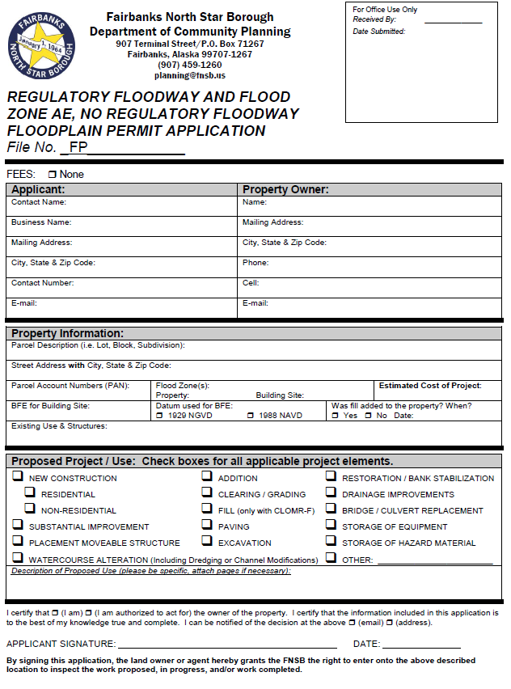
Regulatory Floodway & Flood Zone AE, No Regulatory Floodway
For ANY development in a Regulatory Floodway or in Flood Zone AE without a Designated Regulatory Floodway.
Complete 4-page application.
Submit detailed site plan.
Submit other required documentation (3-page submittal instructions).
  No-Rise Certification with all documentation.
  Copy of required permits.
  Etc.

Slide 26
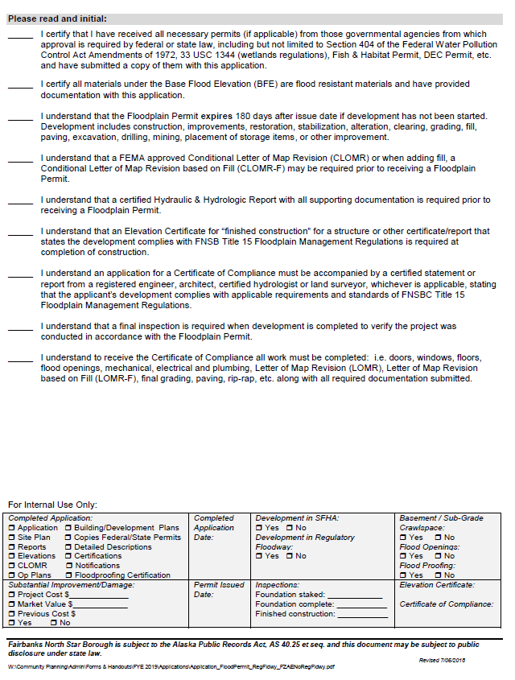
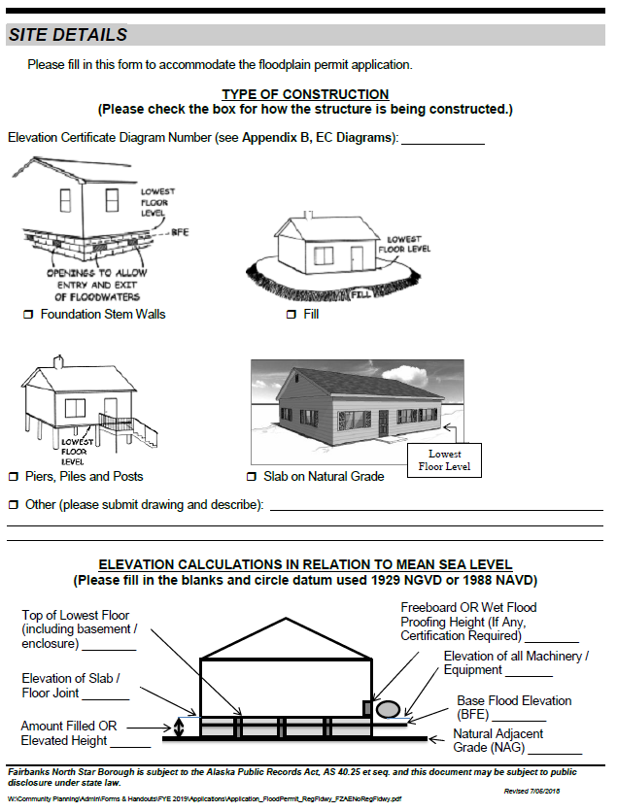
Regulatory Floodway & Flood Zone AE, No Designated Regulatory Floodway (cont.)

Slide 27
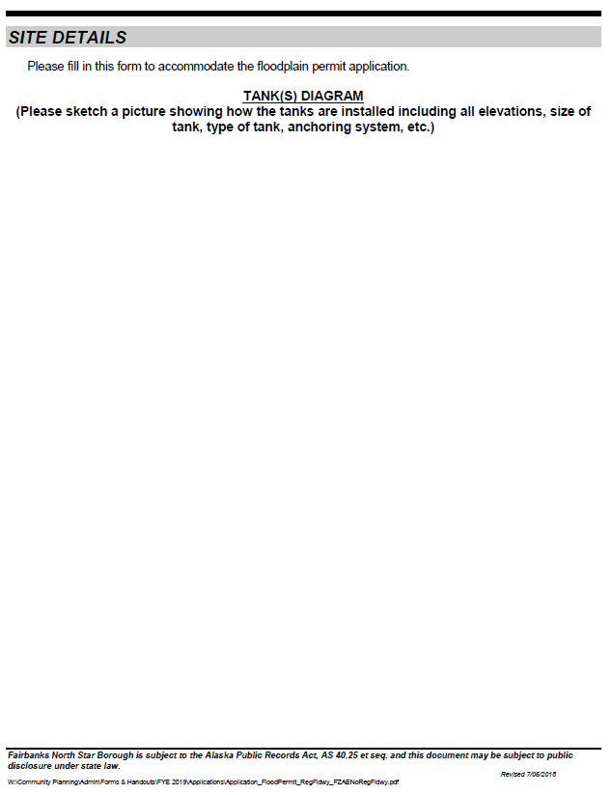
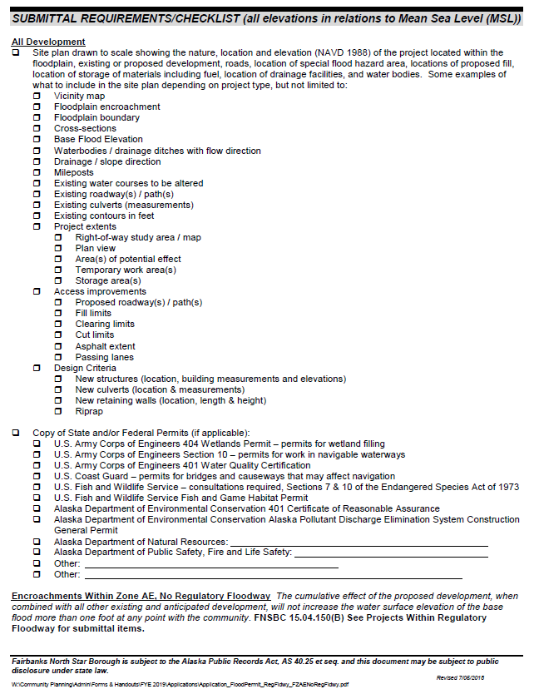
Regulatory Floodway & Flood Zone AE, No Designated Regulatory Floodway (cont.)

Slide 28
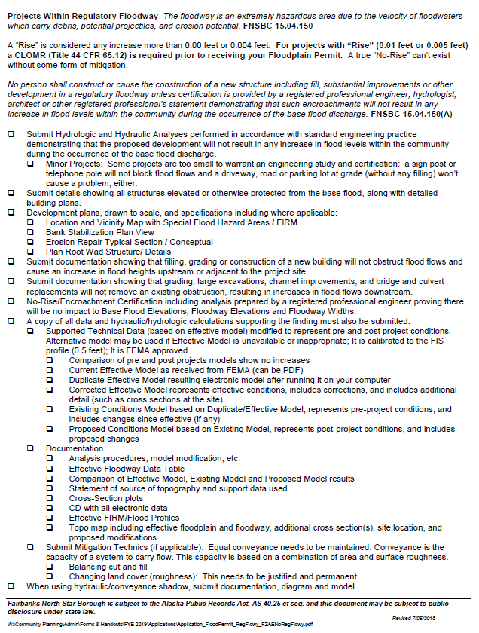
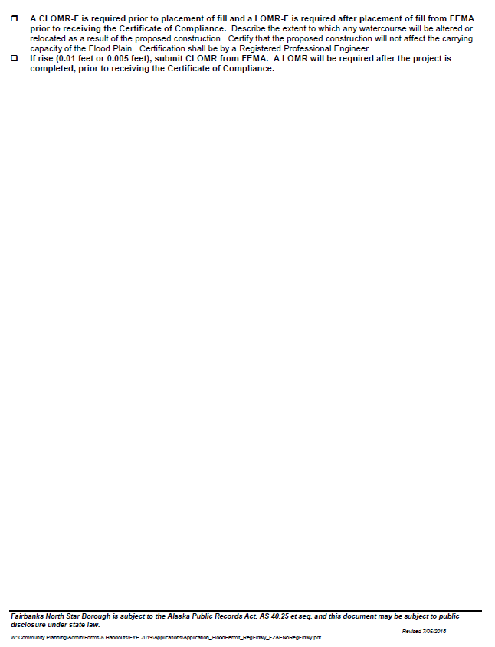
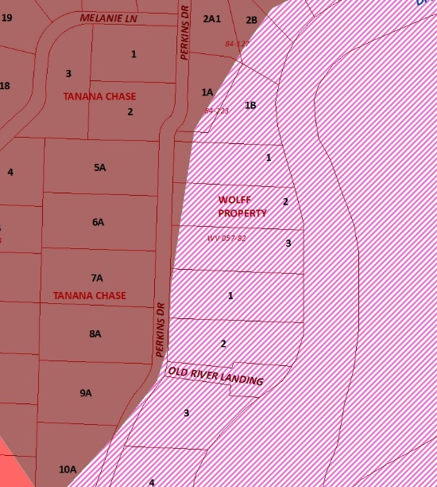
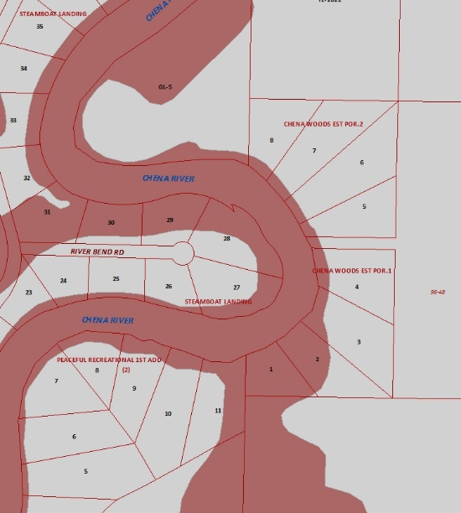
Regulatory Floodway & Flood Zone AE, No Designated Regulatory Floodway (cont.)

Slide 29
Other Flood Applications
Certificate of Compliance
Letter of Map Change
Flood Determination Request($)
Variance Request ($)

Slide 30


Certificate of Compliance

Slide 31


Letter of Map Change
LOMA Process for Structures
Floodplain Permit prior to development
Elevation Certificate for “finished construction”
Certificate of Compliance
Apply for LOMA

Slide 32

Flood Determination Request
$50 Fee
Title 15 written formal document request from
Realtor/Lender
Property Owner
FEMA LOMC
  Formal Letter
  Community Acknowledgement Form

Slide 33

Floodplain Variance
$1,000 Application Fee
$200 Sign Deposit
Complete 1-page application.
Submit detailed narrative addressing all criteria of Title 15 AND Alaska State Land Use Regulations.
Submit current Mortgage Location Survey.
Submit other required documentation (3-page submittal instructions).

Slide 34


Floodplain Variance (cont.)

Slide 35


Floodplain Variance (cont.)

Slide 36


Floodplain Variance (cont.)

Slide 37

Flood Variance Checklist
Variances are rare for properties located in a Special Flood Hazard Area.
A property owner SHALL meet all criteria.
A Community is responsible for the health, safety and welfare of all properties, including those given a variance!

Slide 38


Flood Variance Checklist (cont.)

Slide 39
Zoning 101
Prepared by Melissa Kellner
Long-Range Planner
FNSB Community Planning

Slide 40
What is Planning?
“The goal of planning is to maximize the health, safety, and economic wellbeing of all people living in our communities” – APA
“A… borough shall provide for planning, platting, and land use regulation on an areawide basis.…for the systematic and organized development of the borough” (AS 29.40.010)
“…in order to implement the plan, the assembly by ordinance shall adopt or amend provisions governing the use and occupancy of land that may include, but are not limited to,
  (1) zoning regulations…
  (2) land use permit requirements designed to encourage or discourage specified uses and construction of specified structures, or to minimize unfavorable effects of uses and the construction of structures” (AS 29.40.040)

Slide 41
FNSB Regional Comprehensive Plan
Required by State
Land use decision making framework
Set of Goals, Strategies and Actions
Comprehensive Plan adopted in 2005, map amended in 1990
Zoning code amendments and rezones are required to comply with this plan

Slide 42

FNSB Regional Comprehensive Plan Map

Slide 43

FNSB Sub-Area Plans
City of North Pole Land Use Plan (2010)
Downtown Fairbanks Plan (in progress)
Salcha-Badger Road Area Plan (Adopted 9/12/19)

Slide 44

Current Challenge and Potential Solution
Current FNSB land use policies for the area do not align with existing or desired future land use.
The result:
Conflicting land uses and no guidance for future growth.
The proposed area plan
Future Land Use Map aligns with existing or desired future land use.
The result:
Protection of what residents value most and a clear guide for future growth.

Slide 45

Future Land Use Map
What is it again? How does it relate to existing policies?

Slide 46
Implementing Comp Plan
Amending Regulations
  Zoning
  Rezoning
  Subdivisions
Examples:
Marijuana Facilities
Setbacks
Community Gardens
Urban Livestock

Slide 47




Slide 48



Why Zoning?
Tool used to guide land use in a way that protects public health, safety, and general welfare
  The state has conveyed zoning authority to the FNSB
  The FNSB zoning code (Title 18) groups and separates uses.
    Residential, commercial, industrial etc.
    Other regulations addressing public health, safety, and general welfare.

Slide 49

FNSB Code

Slide 50


FNSB Code Title 18

Slide 51

FNSB Zoning Map

Slide 52

Finding Zoning - FNSB Zoning Map

Slide 53
FNSB Zoning Districts
Permitted Uses – Minimal impact uses that would be allowed with a zoning permit
Conditional Uses – Higher impact uses that may be allowed with conditions after a public hearing
Disallowed uses – Uses that would have a significant impact and are not allowed
Residential
Rural Estates
Rural Residential
Single Family
Two-Family
Multi-Family
Multi-Family / Prof. Office
Agricultural
Commercial
General Commercial
Light Commercial
Central Business District
Industrial
Light Industrial
Rural Farmstead
Rural & Agricultural
Heavy Industrial
Other Zones
General Use

Slide 54

Permitted and Conditional Uses

Slide 55
Permitted and Conditional Uses
Permitted Uses
Zoning Permit
Free, within 5 days
Conditional Uses
Conditional Use Approval
$800-$1000, 2 months

Slide 56
Variances and Rezones
Variances
Planning Commission
$300-1,000,
2 months
Rezone
Assembly
$1,000,
3 months

Slide 57

Zoning Standards
Minimum lot size
Setbacks
Height
Parking
Signage
Outdoor lighting

Slide 58

Zoning Standards - Setbacks
“Setbacks make good neighbors” – FNSB Planning Commissioner
“minimum distances between a structure and a lot line...”
Purpose
Potential street widenings
Traffic Safety
Fire protection
Privacy
Drainage

Slide 59
Other Zoning Tools in Title 18
Overlay zoning designations
  Additional regulations could apply to an area in addition to a primary zone
  Example – Groundwater Protection Overlay
Supplemental requirements
  Additional requirements for certain uses
  Example – shooting ranges, cell towers etc.
Buffer requirements
  locating certain uses at a distance from other uses
  Example – Location of liquor/marijuana stores away from schools

Slide 60
Land Use Impacts and Neighbors
Conditional Uses, Variances and Rezones involve nearby property owners in public hearings
Land use impacts:
  Hours of operation
  Noise
  Odor
  Traffic
  Lighting etc.

Slide 61
Other Agencies and Regulations
FNSBC Title 15: Floodplain Management Regulations
FNSBC Title 17: Subdivision Regulations
City of Fairbanks/North Pole Building Permit
State Fire Marshal Review
Alaska Department of Environmental Conservation
Business Licenses and other permits

Slide 62

Suggestions
Advocacy in long-range planning documents
Boards and Commissions
Rezones
Pre-application meetings
Community meetings
Public outreach/consultation

Slide 63
Other Permits At Community Planning
Address Requests (Emergency Operations $0)
Construction in Right-of-Way: Driveway Permit (Rural Services $60/$120)

Slide 64
Are Permits Required?

Slide 65
What permits are required?

Slide 66

What permits are required?

Slide 67
What permits are required?

Slide 68
What permits are required?

Slide 70


Slide 71
QUESTIONS?

Slide 72

Contact Information
Department of Community Planning
Fairbanks North Star Borough
907 Terminal Street
Fairbanks, AK 99701
Phone: (907) 459-1260
Email: planning@fnsb.us
Nancy Durham, MURP, CFM
Flood Plain Administrator
nancy.durham@fnsb.us
(907) 459-1263

Slide 73
Supplemental slides

Slide 74
Rezones
The Planning Commission shall also consider and adopt findings of fact demonstrating whether or not the proposed rezone conforms to the comprehensive plan and to the public health, safety and welfare. (18.104.020)
Possible recommendations by the PC to the Assembly: (18.104.020)
  Approve
  Approve with special limitations
  Amendment to a more appropriate zone
  Disapprove

Slide 75

Typical Case – Rezone
Ownership
UA-
owned
DNR-
owned

Slide 76

Typical Case – Rezone
Proposed Zoning

Slide 77

Typical Case – Rezone
Existing Land Use
Vacant
land

Slide 78

Typical Case – Rezone
Land Suitability
Most
Suitable
Less
Suitable

Slide 79

Typical Case – Rezone
Comp. Plan

Slide 80
FNSBC Title 18 Rezone Approval Criteria
1. …conforms to the comprehensive plan.
Outskirt Area
Preferred Residential Land
2. …conforms to the public health, safety and welfare
RA-5 and RE-2 zones will limit the development density
Minimize the potential for land use conflicts
Provide some commercial potential to RA-5 lots abutting Goldstream Road
Approved!

Slide 81
Dodd-Frank Act
Signed July 21, 2010
  Before Dodd-Frank
  Assumed grandfather rights are for forever
  Assumed rebuilding after fire/damage
  No documentation was required
  After Dodd-Frank
  Documentation required

Slide 82

Legal Zoning “Nonconformity”
Legally created lots, structures, or uses that no longer comply with zoning standards
Different than violations

Slide 83


Zoning affects marketability

Slide 84


Grandfather Rights
A structure, lot, or use that was legally established according zoning, but does not meet current zoning standards
Was the structure, lot, or use legally established before the zoning requirement came into effect?
2018
1968

Slide 85

Grandfather Rights Requests

Slide 86
Typical Case
Show that structure was created prior to zoning regulations

