Slide 1
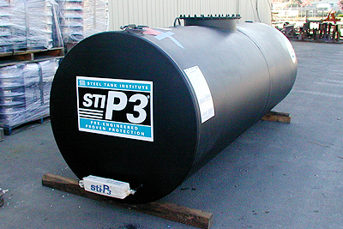
LUST UST or bust
Photo: Greertank.com
Mel Durrett - April 22, 2020

Slide 2
UST =
Underground Storage Tank
Tank plus any connected underground piping
  Where >10% combined volume is underground
Stores
  Petroleum (~546,000 as of Sep 2019)
    Gas stations, sell fuel to the public
    Fleet ops
  Hazardous substances (~3,400 as of Sep 2019)
~2.1 mill USTs when first regulated
  ~1.9 mill USTs have been properly closed
https://www.epa.gov/ust

Slide 3
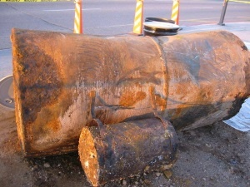
Until 1980s, USTs were made of bare steel…
LUST = Leaking Underground Storage Tank

Slide 4
USTs are regulated to avoid…
Groundwater pollution
  50-240 billions of gallons protected each year
  LUSTs most common source of GW pollution, spec. petroleum
Lost product
Vapor intrusion
Housing values depreciation
  3-6% depreciation after a high-profile release
  4-9% depreciation even after it’s cleaned up
Costs avoided: $120 million per year to $530 million per year (not counting groundwater cleanup)

Slide 5
Regulations
U.S. Code, Title 42, Chapter 82, Subchapter IX
  Includes amendments to Solid Waste Disposal Act of 1984
    Created UST program
    LUST Trust Fund established 1986 for cleaning up leaks
  Energy Policy Act of 2005 Title XV, Subtitle B
    Underground Storage Tank Compliance Act of 2005
    Provisions focus on preventing releases
  Gives EPA authority to regulate USTs
  2015 Updated codes, biofuel regs
EPA regulates USTs in Indian country
38 States have their own UST programs, others have primacy to implement EPA program
  Alaska regs: 18 AAC 78, Article 1
  Alaska Department of Environmental Conservation (ADEC)

Slide 6
Do all tanks have to meet federal EPA regulations?
These USTs do NOT need to meet federal requirements for USTs:
Farm and residential tanks of 1,100 gallons or less capacity holding motor fuel used for noncommercial purposes;
Tanks storing heating oil used on the premises where it is stored;
Tanks on or above the floor of underground areas, such as basements or tunnels;
Septic tanks and systems for collecting storm water and wastewater;
Flow-through process tanks;
Tanks of 110 gallons or less capacity; and
Emergency spill and overfill tanks.

Slide 7
Alaska DEC
Spill Prevention and Response
  Contaminated Sites Program
    Underground Storage Tank staff
This unit’s primary activities include:
  Provides technical assistance to UST owners/operators
  Performs audits of third-party UST inspectors
  Reviews third-party inspection reports for UST systems
  Oversees UST certified worker program
  Oversee regulated UST installs and closures

Slide 8
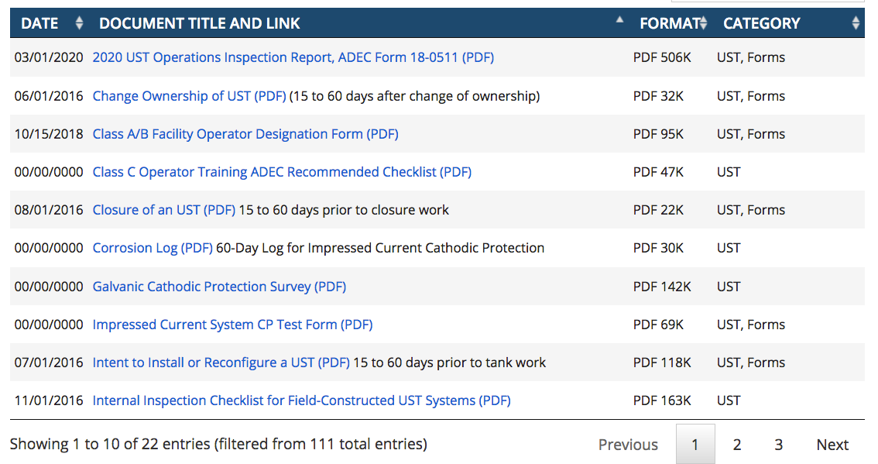
https://dec.alaska.gov/spar/csp/guidance-forms?search=ust

Slide 9
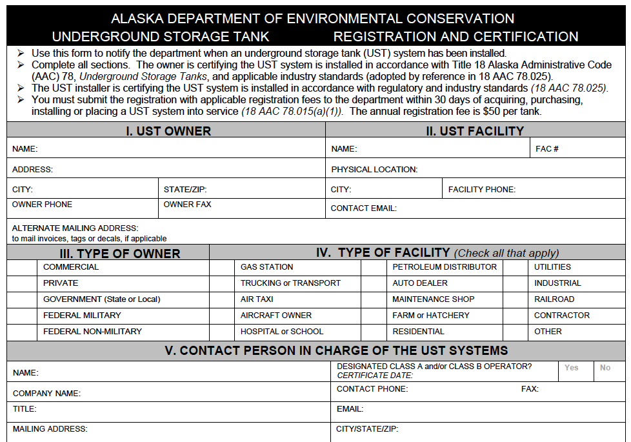

Slide 10
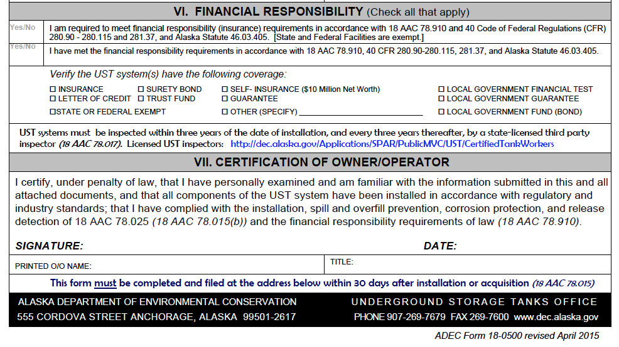
Financial Responsibility

Slide 11
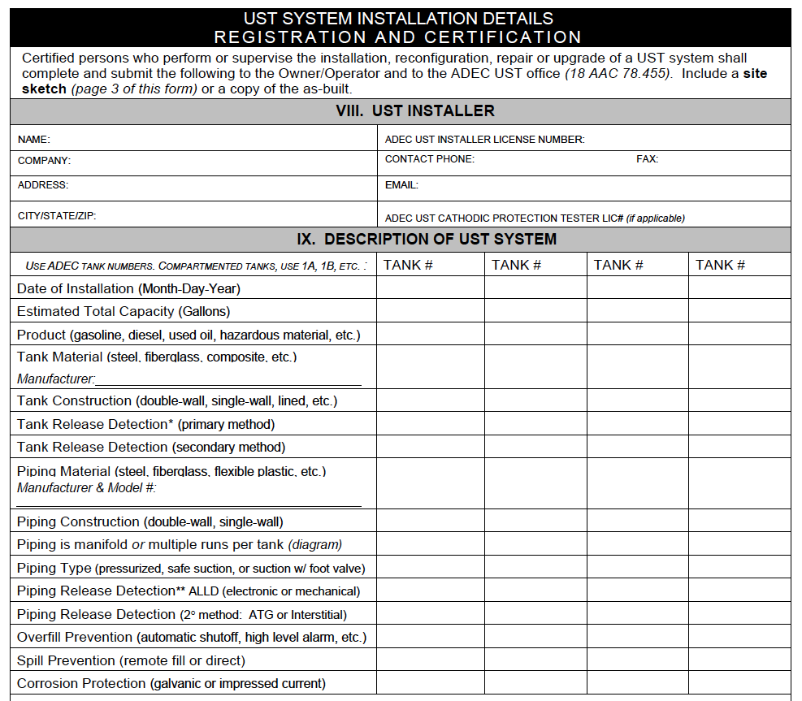

Slide 12
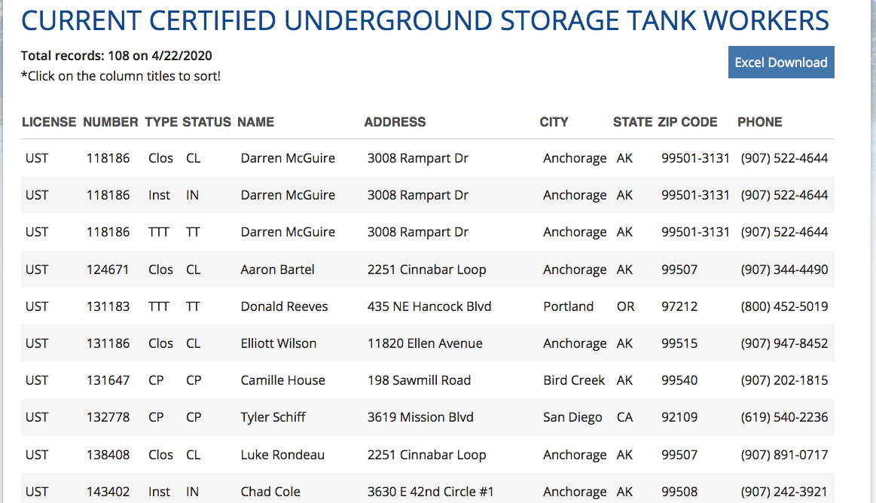
DEC certifies UST Operators, Tank Workers, and Third-Party Inspectors
Notes:
Key
Type: CP = Cathodic Protection; Clos = Closure; Insp = Inspector; Inst = Installer; TTT = Tank Tightness Tester

Slide 13
Extra steps for emerging fuels
Emerging fuels have drastically increased market volume in last decade
  gasoline blends containing >10% ethanol;
  diesel blends containing >20% biodiesel;
  or any other substance identified by an implementing agency now or in the future, e.g. Isobutanol
All UST systems must be compatible with the regulated substances they store.
additional notification, demonstration, and record keeping actions of owners wishing to store biofuels

Slide 14
Emerging Fuel | Common Name | Does it contain biofuel? | Must UST owner meet additional compatibility requirements?
Ultra-low sulfur diesel (ULSD) | Diesel | Possibly biodiesel up to 5%. | No. This fuel is common across the US.
Ultra-low sulfur gasoline (ULSG) | ULSG, E10, gasoline | Yes, usually ethanol at 10%. | No. This fuel is common across the US.
E15 | E15 | Yes, 15% ethanol. | Yes. Must demonstrate compatibility of the UST system.
E85 | E85 | Yes, 51-83% ethanol. | Yes. Must demonstrate compatibility of the UST system.
B20 | B20 | Yes, 6-20% biodiesel. | No. Up to B20 is commonly stored by fleet operators.
B50 | B50 | Yes, 50 percent biodiesel. | Yes. Must demonstrate compatibility of the UST system.
B99 | B99 | Yes, 99 percent biodiesel. | Yes. Must demonstrate compatibility of the UST system.
Isobutanol | Isobutanol, biobutanol | Yes | Yes. Must demonstrate compatibility of the UST system.
Renewable diesel | Renewable diesel | No | No. Made from biocomponents, but chemically similar to diesel.
Renewable gasoline | Green gasoline | No | No. Made from biocomponents, but chemically similar to gasoline.
Notes:
https://www.epa.gov/ust/emerging-fuels-and-underground-storage-tanks-usts

Slide 15
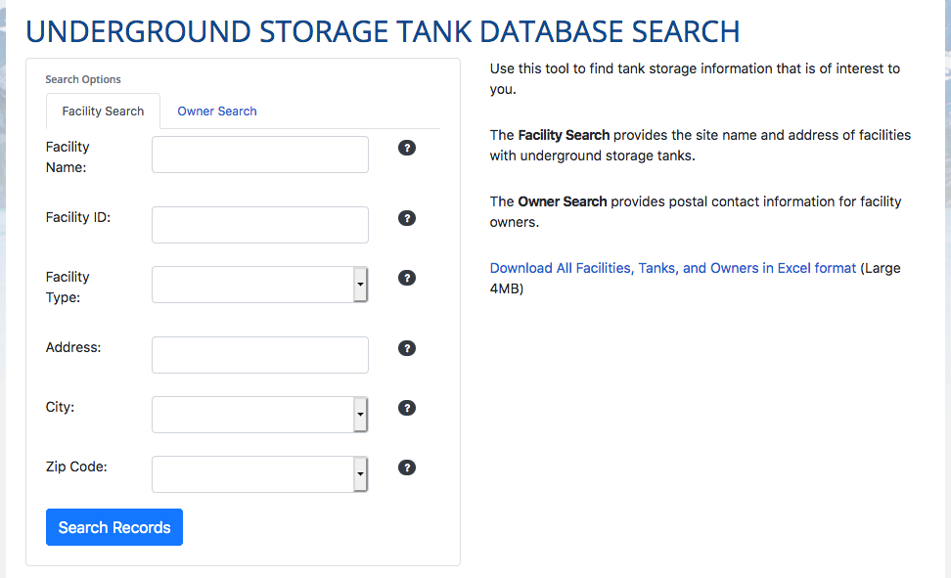
UST Database
Notes:
https://dec.alaska.gov/Applications/SPAR/PublicUST/USTSearch

Slide 16
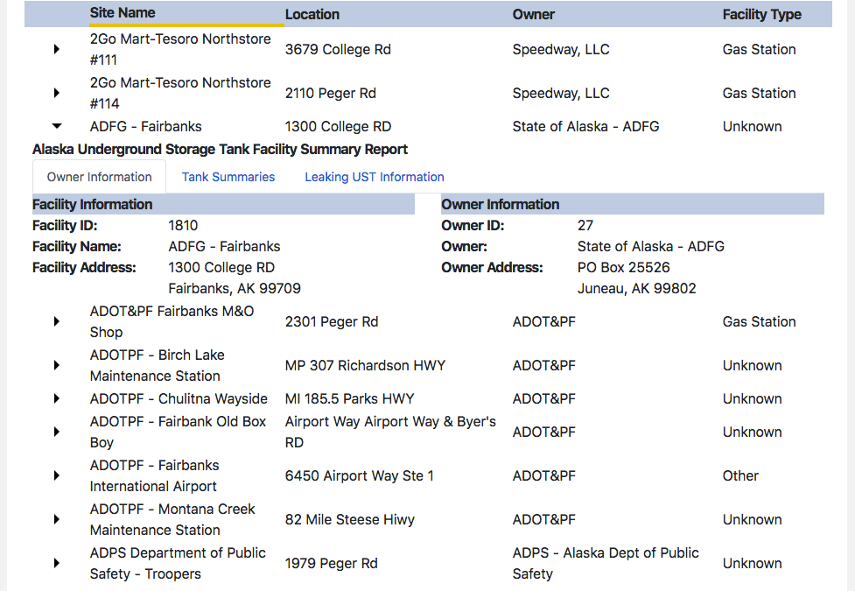

Slide 17
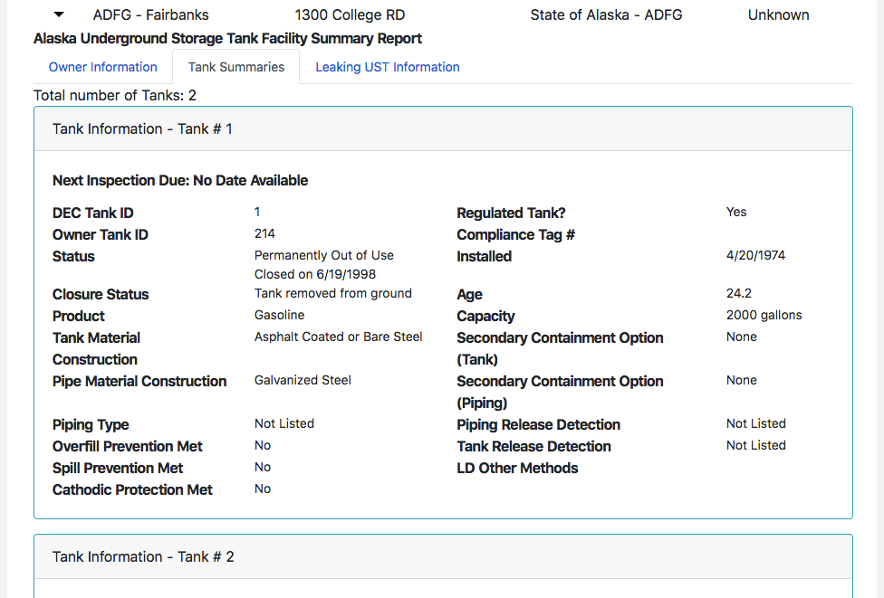

Slide 18
Monitoring
Owners and operators of regulated underground storage tank (UST) systems are required to monitor release detection on tanks and piping at least once every 30 days and to retain those records.
Each UST system must have a minimum of 12 months to be in compliance for recordkeeping, and no two consecutive months may have ‘inconclusive’ or ‘failed’ results.
Owners and/or operators must provide the records during inspections (18 AAC 78.100(h)(2)).
If 12 months of records are not retained for these requirements, then the UST system will be placed on Leak Detection Probation (LDP) for a minimum of 12 months.

Slide 19
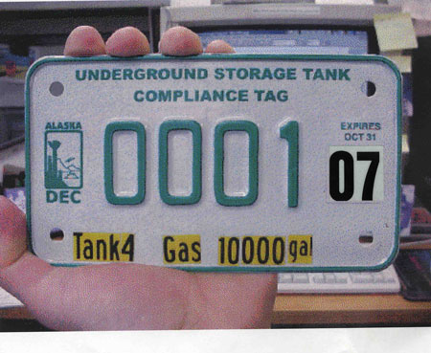
Third-party Inspections
Once every 3 years, an owner or operator must hire a certified Operations Inspector (PDF 53K) to ensure the UST system is in compliance with release detection, spill and overfill prevention and corrosion protection.
The tank owner\operator has up to 120 days to correct deficiencies found during inspection without penalty.
Once your tank passes inspection, inspection reports must be submitted to DEC as indicated on the report form. We will then issue you a tank tag permitting you to receive fuel.

Slide 20
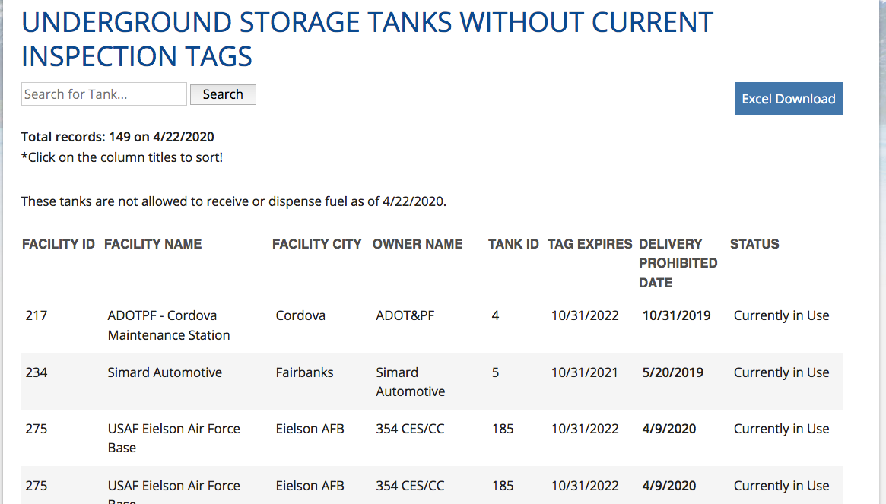

Slide 21
Failure of Inspections or Monitoring → Leak Detection Probation
If a UST system fails the third-party operations inspection for leak detection equipment on tank or piping, the failed component is required to be upgraded, replaced or fixed within 60 days of the inspection (18 AAC 78.017(k)(4)
  a. Extensions may be approved upon a written request accompanied by detailed repair information and a corrective action schedule
  b. A fuel authorization may be issued during that period and LDP may be in effect after the corrective work is complete.
If a UST system fails the third-party operations inspection for recordkeeping, that is, not having 12 months of acceptable records on hand, the inspector and owner/operator may sign an LDP Agreement (page 13) for 12 months
  a. The department will issue a fuel authorization letter for the 12-month LDP
  b. The owner/operator agrees to submit the monthly records to the inspector
  c. The inspector will monitor progress and provide technical assistance
  d. If 12 months of acceptable records are received, the inspector will recommend to the department that LDP be completed
  e. The department will issue the current decal for the tank’s compliance tag.

Slide 22
What if you have a LUST???
(i.e. you find a leak)
Owner/operator must…
notify DEC within 24 hours
take immediate action to prevent any further release, including removing the petroleum from the tank if necessary
stop using the system
visually inspect any above-ground release or exposed below-ground release
monitor and fix any fire and safety hazards from vapors or free product
stockpile or treat any excavated contaminated soils to prevent water run-on or run-off, following DEC-approved methods

Slide 23
Responsibility for a LUST:
Owner & Operator
The owner and operator of the underground storage tank are legally responsible for cleaning it up.
  If the owner or operator believes someone else is responsible for the contamination, he or she should give that information to the DEC project manager for the site.
  It’s best to identify and work with all potentially responsible parties from the beginning of the cleanup process so everyone understands their responsibilities.
Cost Recovery
  The State of Alaska is authorized, under Federal regulation 42 U.S.C. 699 1 b(h), to recover State funds used during oversight of a petroleum cleanup from a leaking underground storage tank (LUST).
  The State is also authorized by Alaska Statute 46.08.070 to recover money expended by the Department to contain or cleanup the release of oil or a hazardous substance, including petroleum.

Slide 24
Cleanup Process for LUST
Owner/operator hires a qualified environmental professional = impartial third party
Follow the Underground Storage Tanks Procedures Manual (updated Mar 22, 2017)
Process
  Scoping – extent?
  Conceptual Site Model – first estimate: source, threat
  Release Investigation – sampling, overseen by DEC
    Report within 45 days
  Cleanup levels – targets vary by contaminant, place, etc.
  Risk Assessment – info to/from stakeholders
  Corrective Action Plan
    Interim plan required within 60 days of the release
  Final Corrective Action Report after the work
  Site closure/Institutional Controls – limits exposure

Slide 25
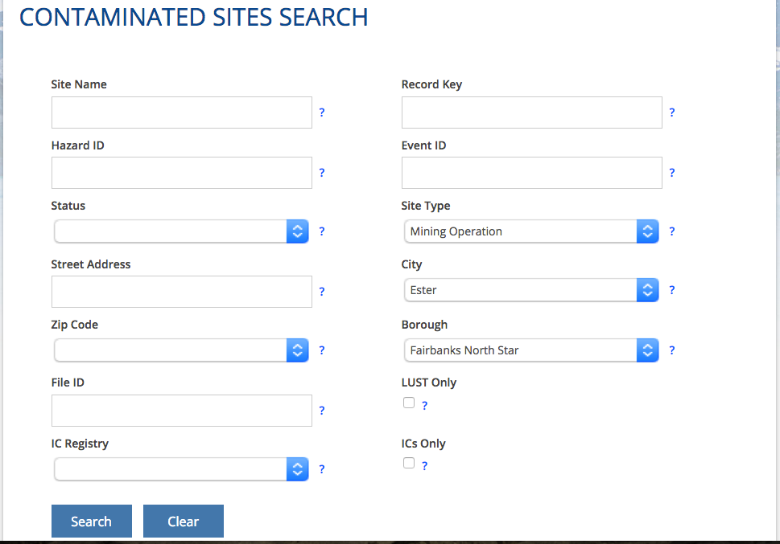
https://dec.alaska.gov/Applications/SPAR/PublicMVC/CSP/Search/
Notes:
https://dec.alaska.gov/Applications/SPAR/PublicMVC/CSP/Search/

Slide 26
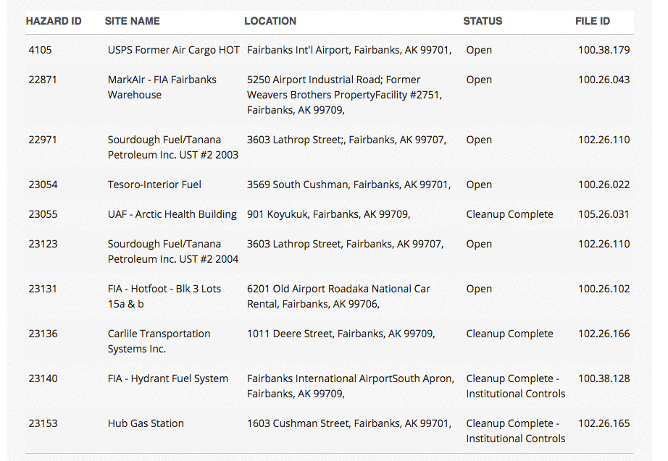

Slide 27
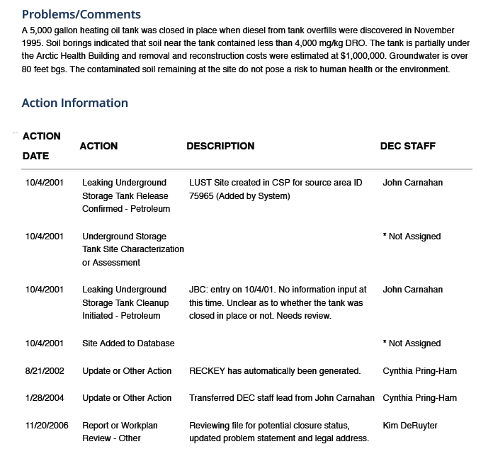

Slide 28
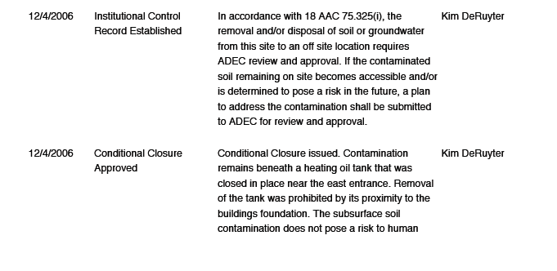
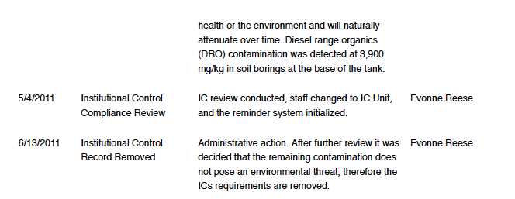

Slide 29
Contacts
Larry Brinkerhoff, UST Prevention Manager
Alaska Department of Environmental Conservation
555 Cordova Street
Anchorage, AK 99501-2617
Telephone: 907-269-3055
Fax Number: 907-269-7687
https://dec.alaska.gov/spar/csp/contact/

