Slide 1
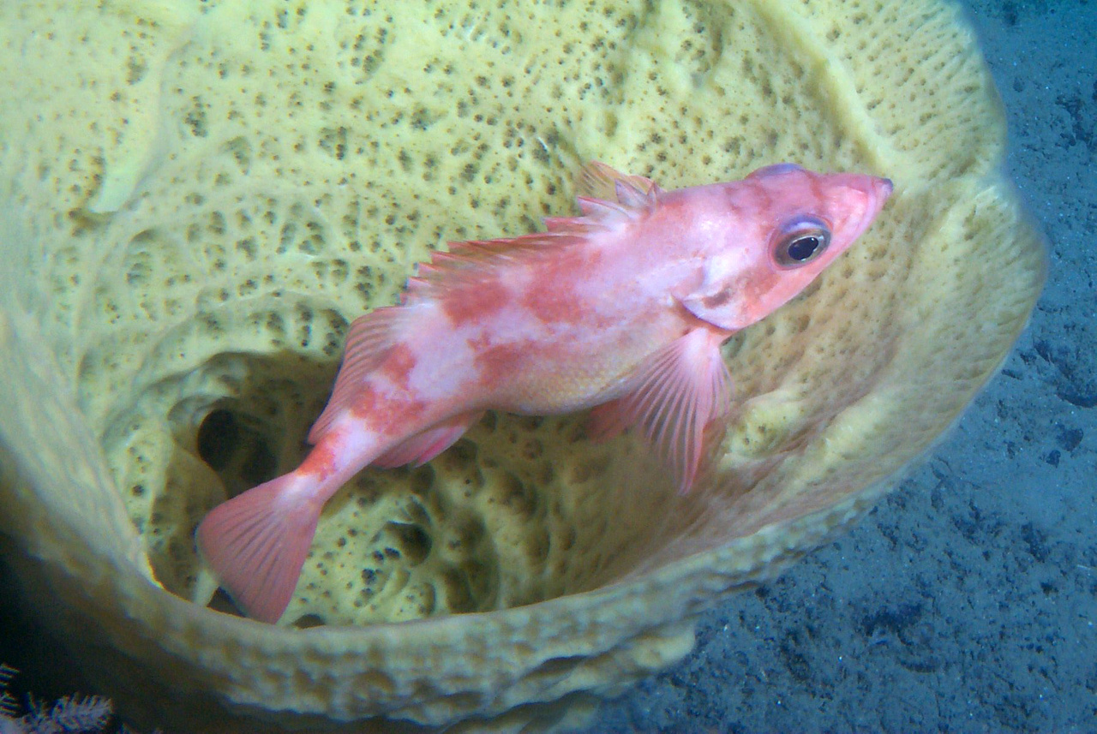
Essential Fish Habitat Consultation
Caitlin Smoot
ENVE 644
15 April 2020
NOAA NMFS

Slide 2
Essential Fish Habitat (EFH)
Defined in 1996 amendments to Magnuson-Stevens Act (MSA) as:
"those waters and substrate necessary to fish for spawning, breeding, feeding or growth to maturity "
Provisions are in 50 CFR Part 600
Based on best-available science (EFH updated in 5 year cycles)
National Oceanic Atmospheric Administration (NOAA) Fisheries works with regional fisheries councils to define EFH
In Alaska EFH is defined in Fishery Management Plans (FMPs) developed by the North Pacific Fishery Management Council
Section 305(b) of MSA requires federal agencies to consult with NOAA Fisheries if activities may adversely impact EFH

Slide 3
Habitat Areas of Particular Concern (HAPCs)
HAPCs meet the following conditions:
Major ecological functions
Sensitivity to decline
Stress from development
Rare habitat
NOAA NMFS

Slide 4
Essential Fish Habitat Consultation
Needed if federal agency has authorized, funded, or undertaken part or all of a proposed activity
The action will adversely affect EFH
An adverse effect is any impact that reduces the quality and/or quantity of EFH
Includes direct or indirect physical, chemical, or biological alterations of the waters or substrate and loss of, or injury to, benthic organisms, prey species and their habitat, and other ecosystem components
May result from actions occurring within EFH or outside of EFH and may include site-specific or habitat-wide impacts, including individual, cumulative, or synergistic consequences of actions
If a federal agency determines that an action will not adversely affect EFH, and NOAA Fisheries agrees, no consultation is required.
https://www.fisheries.noaa.gov/national/habitat-conservation/consultations-essential-fish-habitat

Slide 5
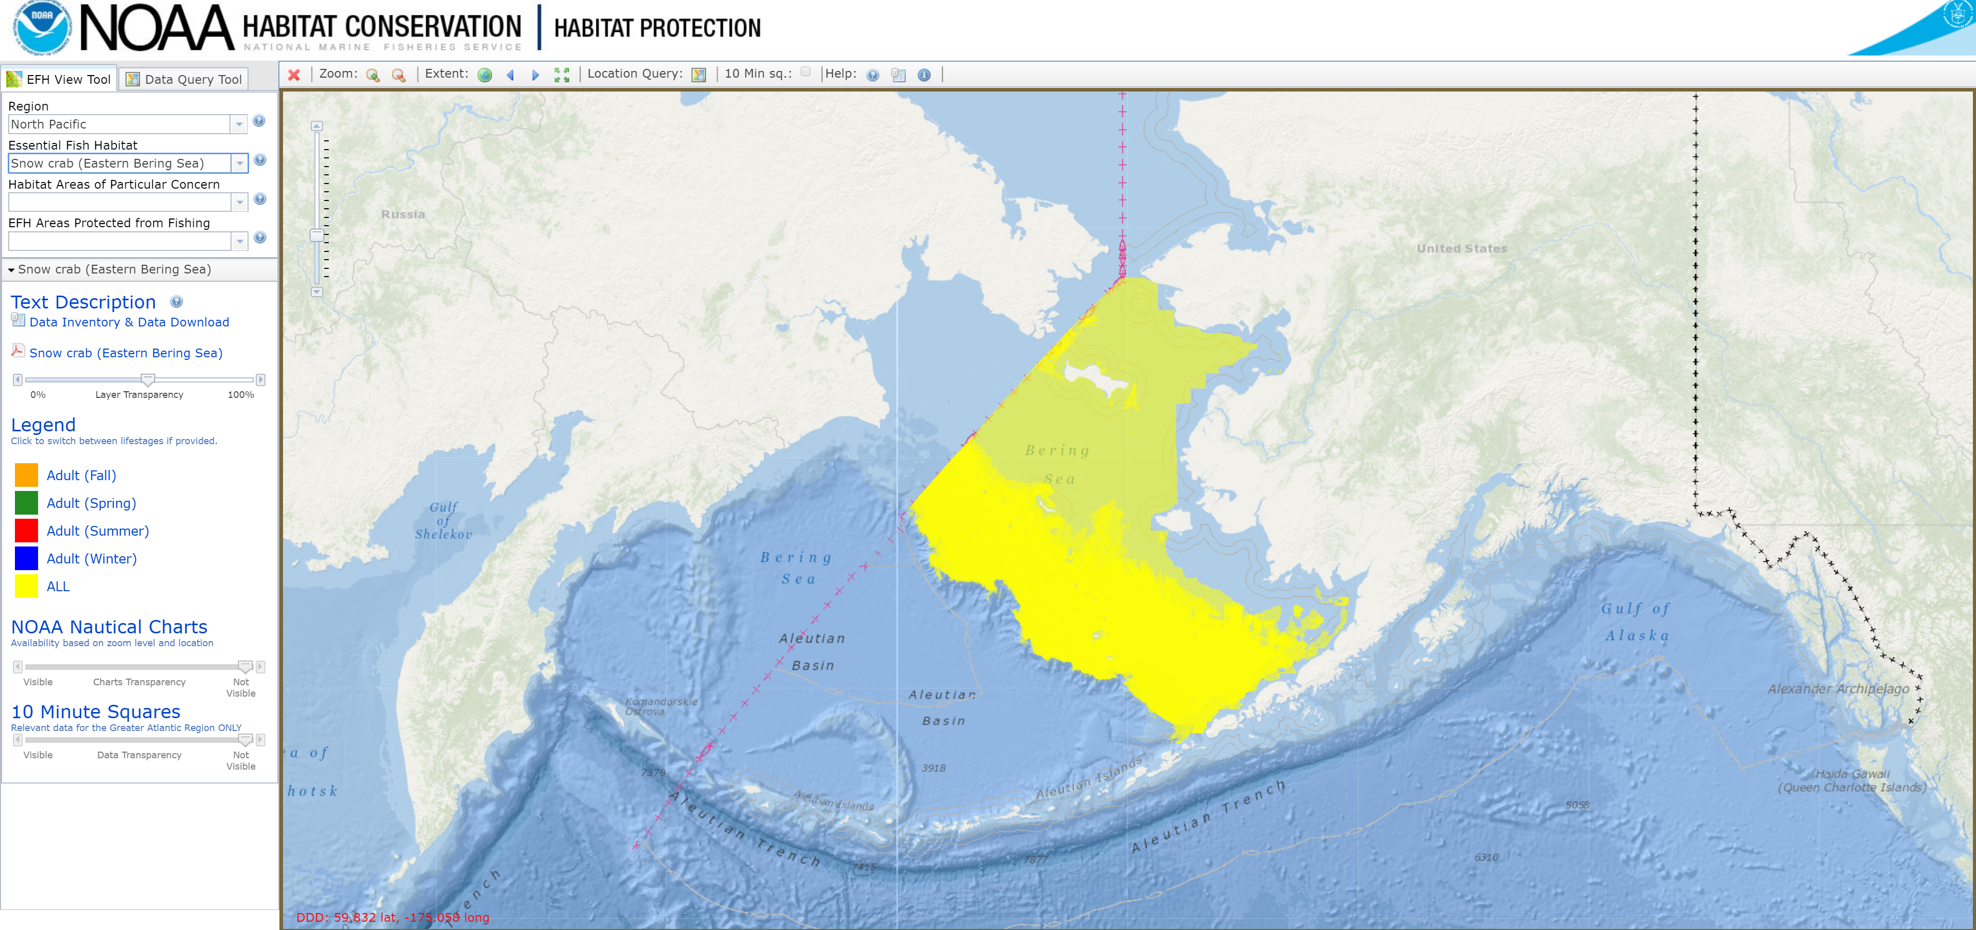
Essential Fish Habitat Mapper
https://www.adfg.alaska.gov/sf/SARR/AWC/index.cfm?ADFG=main.interactive
https://www.habitat.noaa.gov/application/efhmapper/index.html

Slide 6
Essential Fish Habitat Consultation
If an action may adversely impact EFH, an EFH Assessment is required. This must include:
Description of the action
Analysis of the potential adverse effects of the action on EFH and the managed species
Conclusions regarding the effects of the action on EFH
Mitigation measures

Slide 7
Will action will impact EFH?
(Use EFH Mapper)
NO
No EFH consultation required
YES
Notify NOAA Fisheries & begin EFH consultation
(Could be in form public notice, DEIS/EA)
Submit EFH Assessment to NOAA Fisheries
NOAA Fisheries highly encourages EFH Assessments to be combined with other environmental review processes such as NEPA, CWS, ESA
NOAA Fisheries reviews EFH Assessment and provides feedback & recommendations
30-60 days
(Not binding)
Respond to NOAA Fisheries within 30 days

Slide 8
Essential Fish Habitat Contacts
https://www.fisheries.noaa.gov/contact-directory/regional-essential-fish-habitat-coordinators

Slide 9
Essential Fish Habitat Consultation Summary
Provisions for EFH are found within Magnuson-Stevens Act
If federal actions (including federally funded or permitted actions) will adversely impact EFH, an EFH consultation is required
Consultation process includes submittal of EFH Assessment document to NOAA Fisheries. This can be (and is encouraged to be) included with other environmental review documents such as those required for NEPA, CWA, ESA
NOAA Fisheries provides non-binding recommendations
NOAA NMFS

