Slide 1
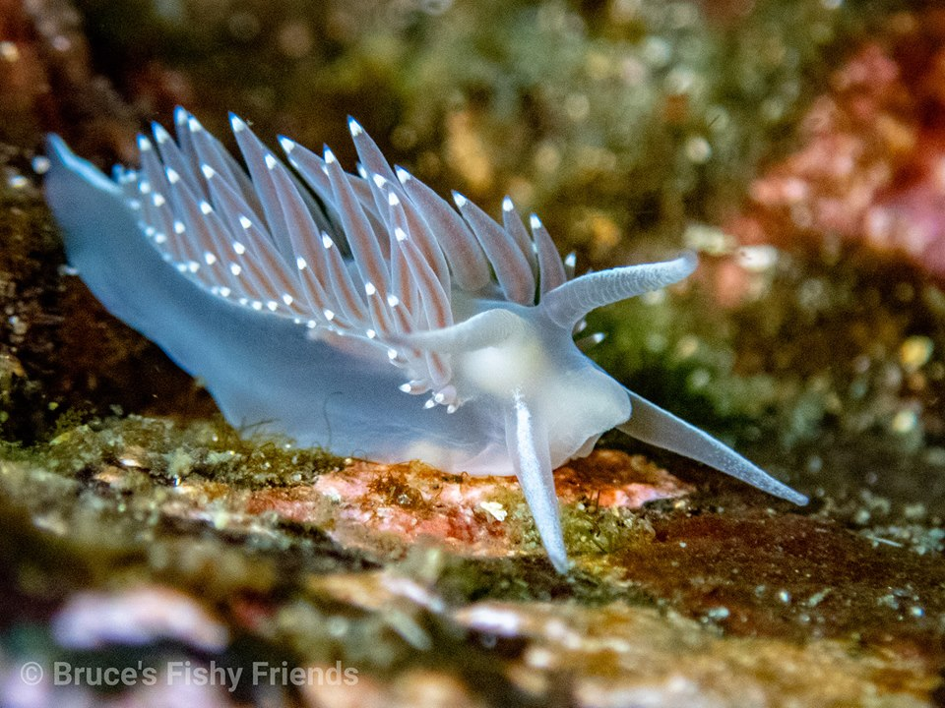
NuDIBRANCHS
OKAY FINE…
FEDERAL AVIATION ASSOCIATION (Faa)
ENVIRONMENTAL MANAGEMENT AND PERMITTING
ENVE 644 SPRING 2020
SOPHIA TIDLER

Slide 2
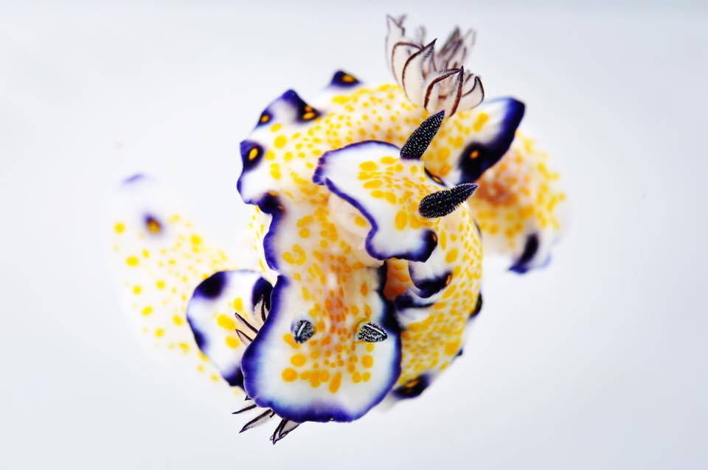
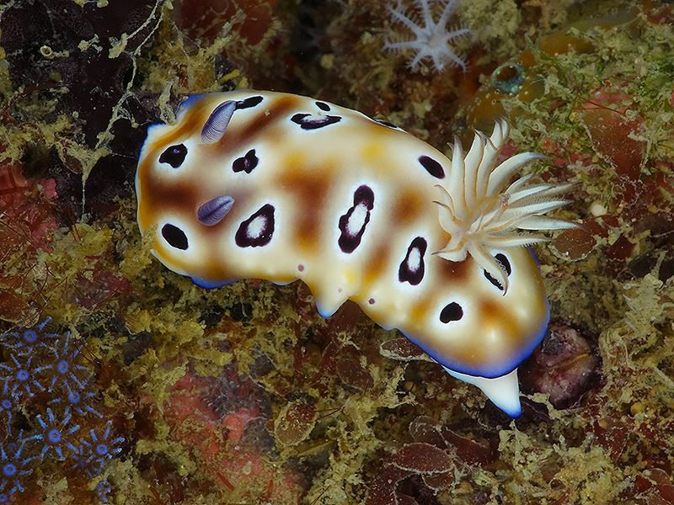
FAA: WHAT IT BE?
SAFETY REGULATIONS
AIRSPACE AND AIR TRAFFIC MANAGEMENT
AIR NAVIGATION FACILITIES
NUDIBRANCH DISCOVERING
CIVIL AVIATION ABROAD
COMMERCIAL SPACE TRANSPORTATION
RESEARCH, ENGINEERING, AND DEVELOPMENT
NUDIBRANCH DISCOVERING
OTHER PROGRAMS/ORGANIZAIONS
https://www.youtube.com/watch?v=9KguBoIHI4I

Slide 3

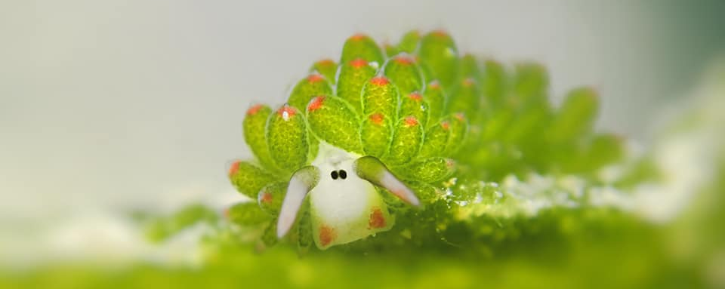
Faa: Who it be?
National Leaders: White dudes age 50-75
Alaska Region (Region 25):
https://www.faa.gov/airports/alaskan/about_airports/media/airports-personnel-aal.pdf
Underwater Region: Sea Slug Sammy

Slide 4
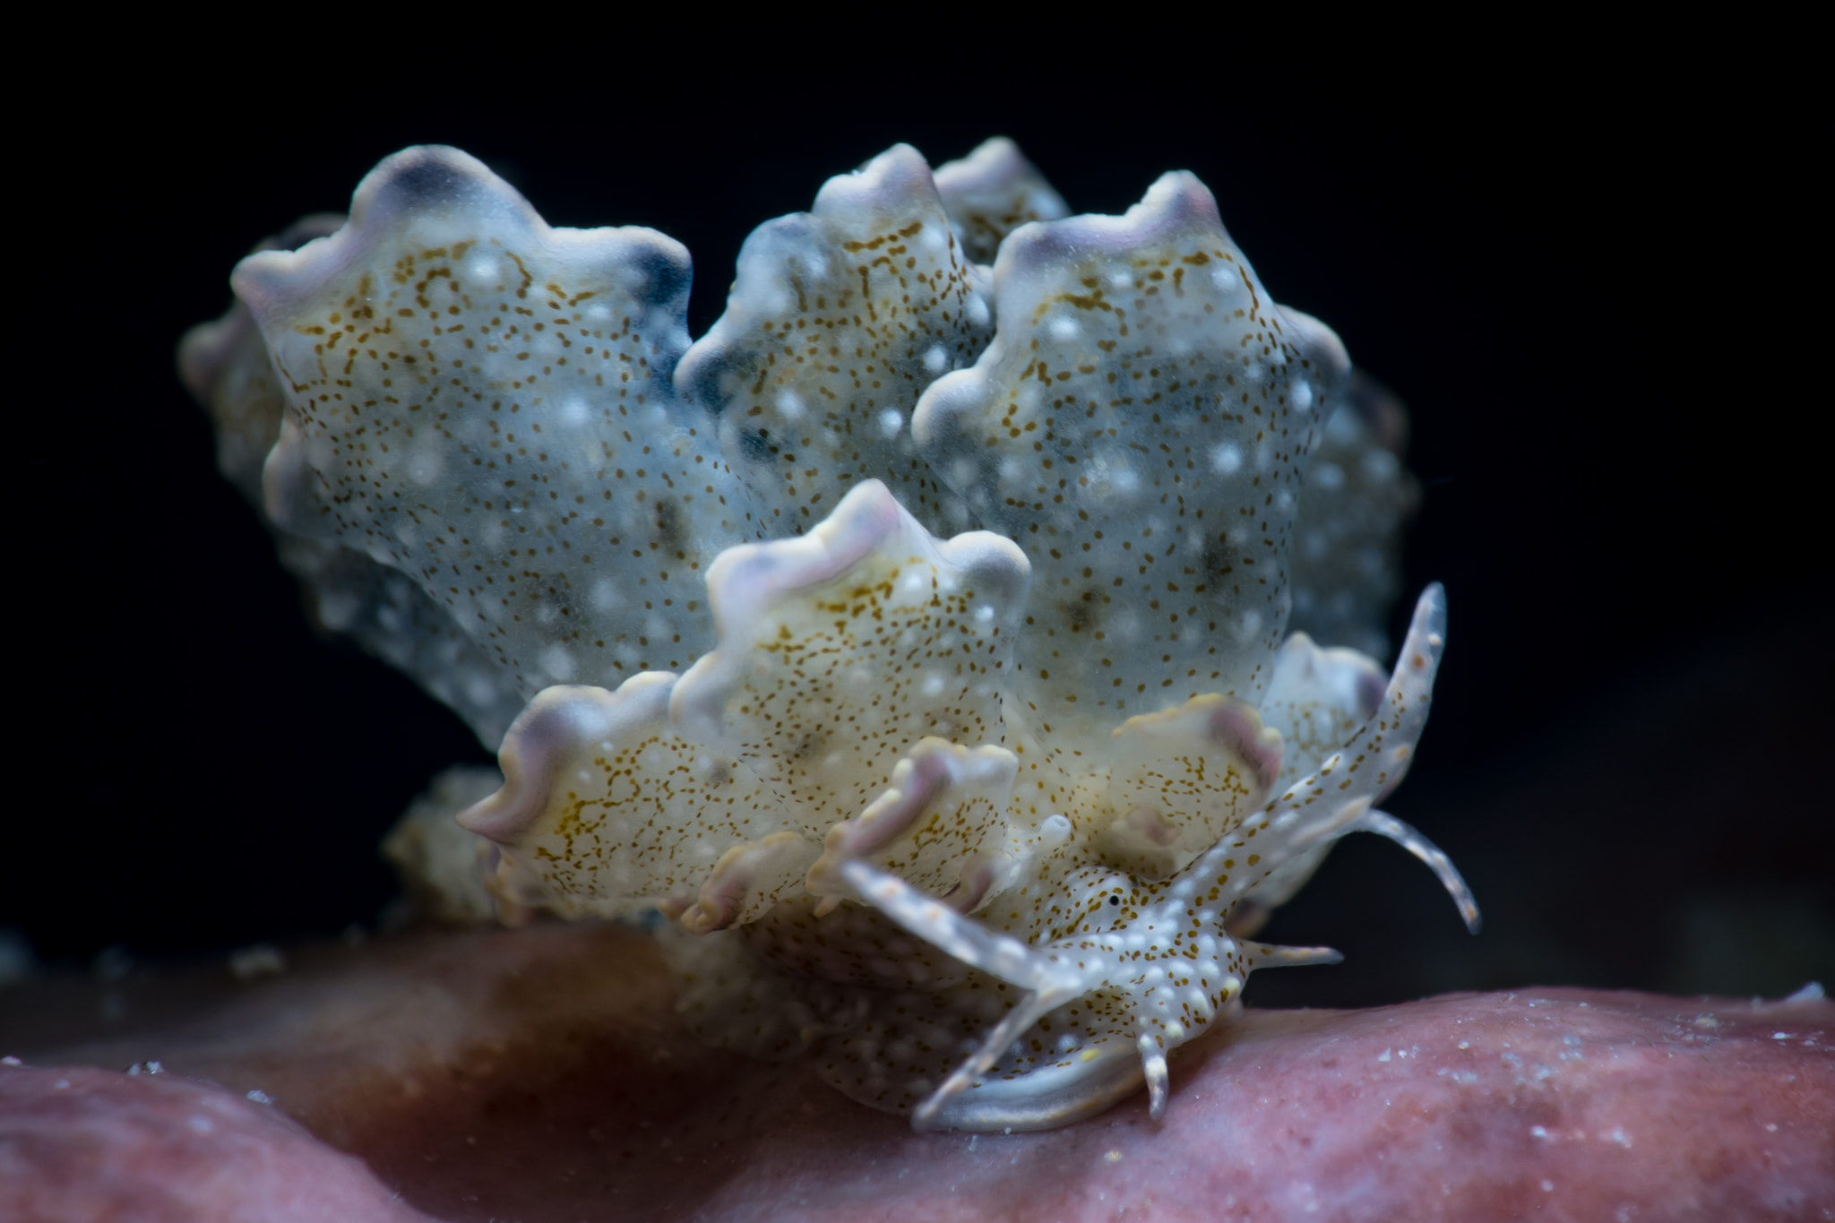
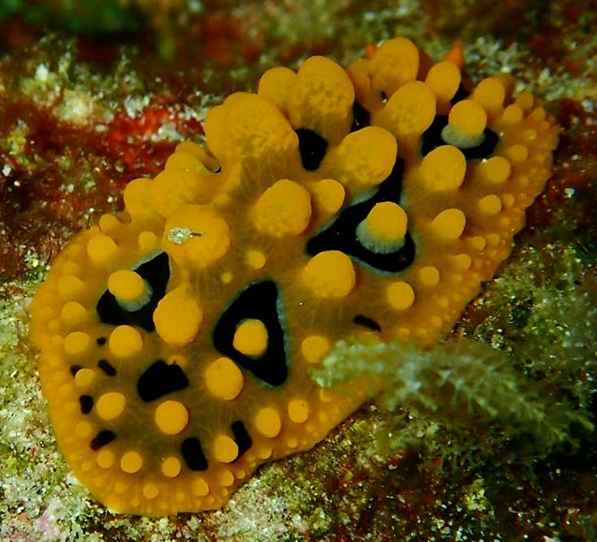
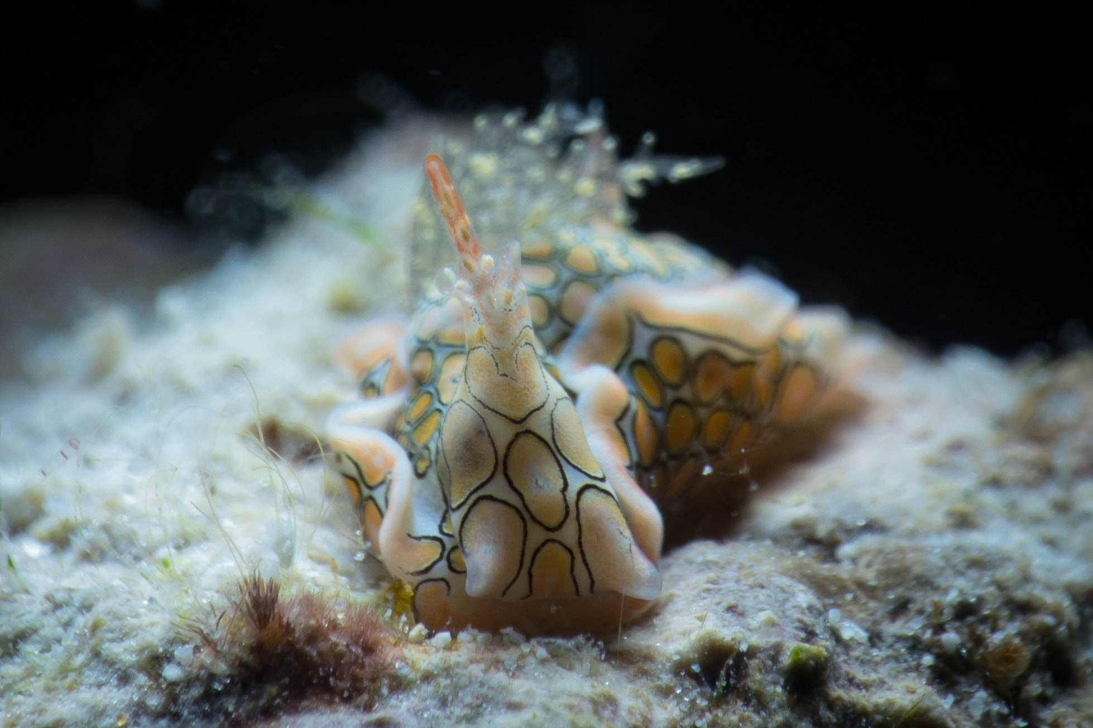
National policy, resources, AND ENVIRONMENTAL ORDERS
AIRPORT AIR QUALITY
AIRPORT ENVIRONMENTAL REVIEW PROCESS (NEPA)
AIRPORT NOISE
AIRPORT RECYCLING
AIRPORT SUSTAINABILITY
COMPATIBLE LAND USE
ENVIRONMENTAL RECORDS OF DECISION
ACQUIRING LAND FOR AIRPORT AND RELOCATION ASSISTANCE
WILDLIFE HAZARD MITIGATION
ENVIRONMENTAL DUE DILLIGENCE AUDITS (EDDA)
ENVIRONMENTAL IMPACTS: POLICIES AND PROCEDURES
NEPA IMPLEMENTATION
PREVENTION, CONTROL AND ABATEMENT OF ENVIRONMENTAL POLLUTION AT FAA FACILITIES
BLAH BLAH BLAH

Slide 5
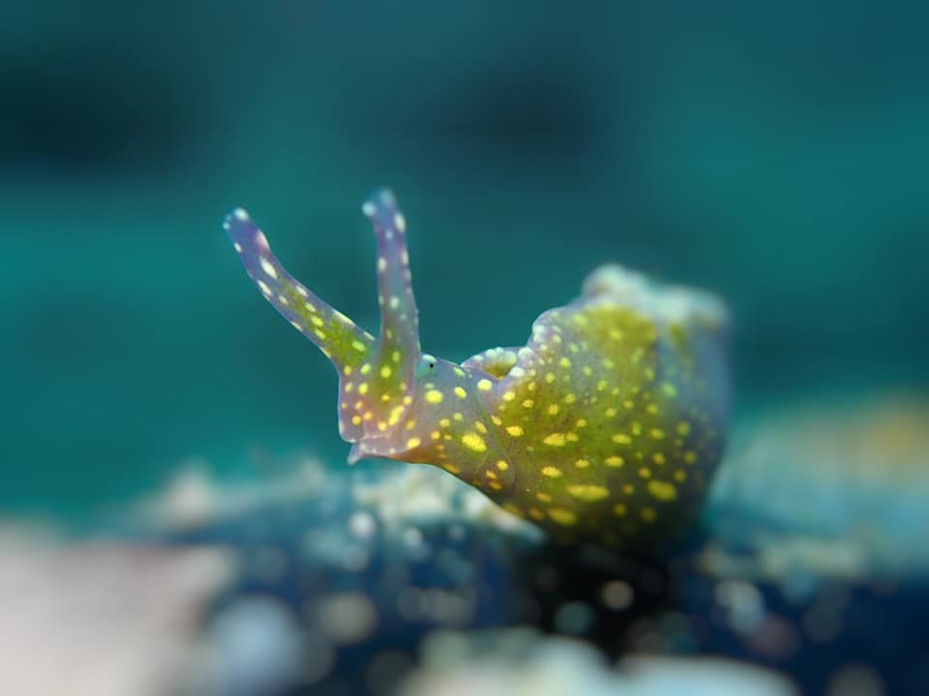
Okay… gimme specifics
FAA Form 7460-1
Applicability
  Construction/alteration exceeding 200 feet above ground level (AGL)
  Construction or alteration:
    Within 20,000 feet of public use/military airport
    Within 5,000 feet of public use heliport
  Any highway, railroad or other traverse way whose prescribed adjusted height is >200 feet AGL
  When requested by the FAA; or
  any construction or alteration located on airport or heliport
(“SOPHIE… this is your future self reminding you to share info from 77.9)
https://www.faa.gov/documentLibrary/media/Form/FAA_Form_7460-1_2017.pdf
Currently, about 3,000 valid species of nudibranchs are known.

Slide 6
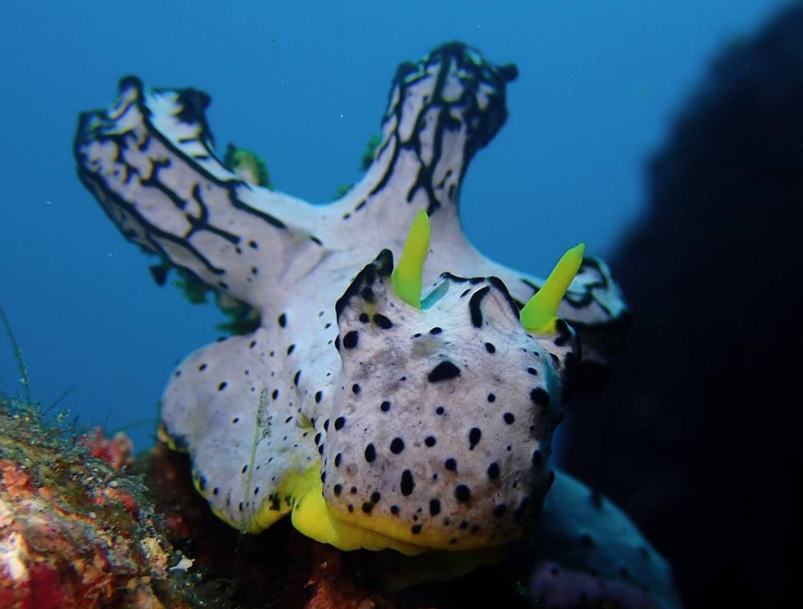
Landfills – so specific…
PER FAA safety standards, required separation distance is a minimum of 6 miles between a new MSWLF and a public airport.
Rural Alaska is different (as always). Landfill sites require a waiver from the FAA if they are located less than one mile from the airport (or not, and they operate illegally and somehow things just work out…)
WHY?
  Waste attracts birds… plane strike birds… plane goes down… birds die… no one wins
  FAA database shows more than 59,000 civil aircraft sustained strikes with wildlife from 1990 to 2004 - costing over $495 million/year in aircraft damage and 631,000 hours/year of aircraft down time.

Slide 7
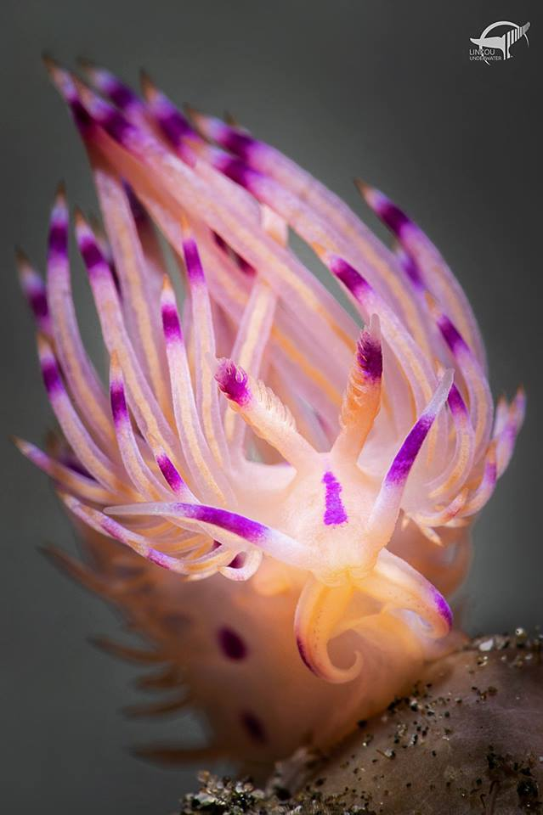
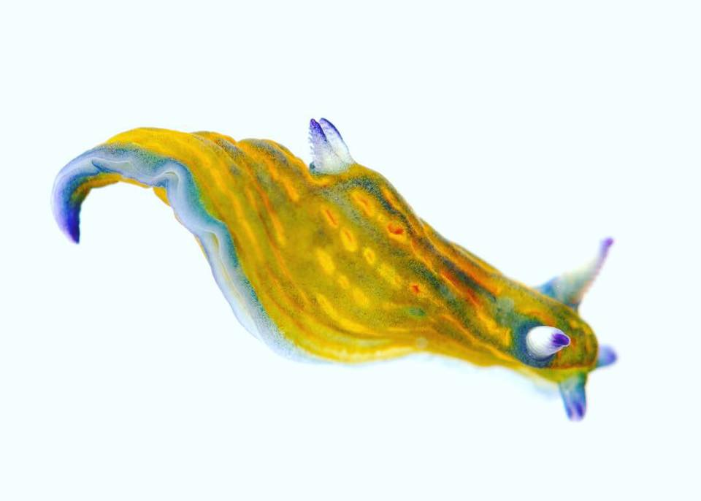
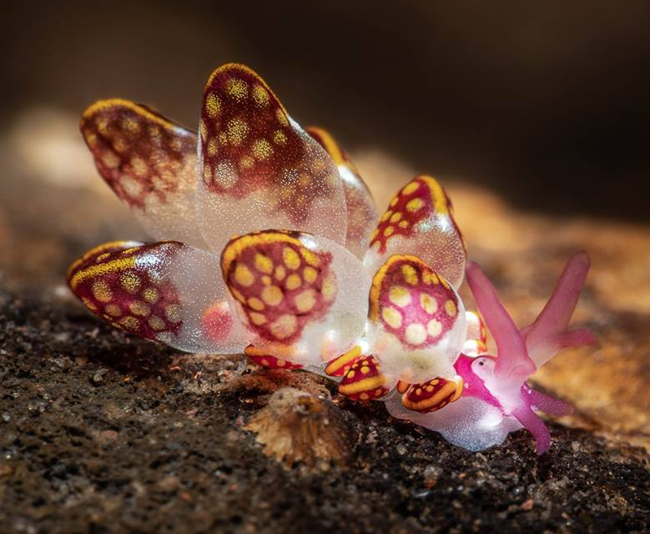
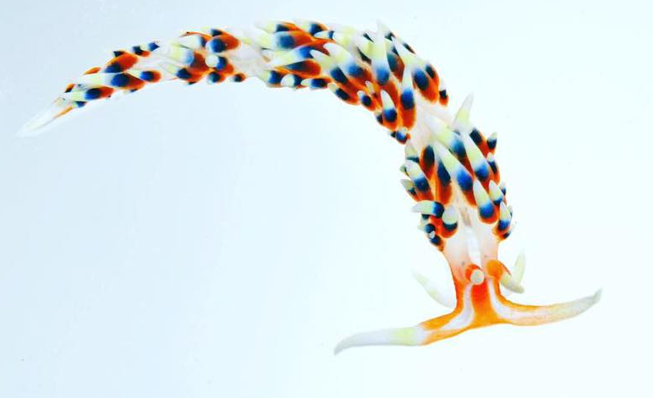
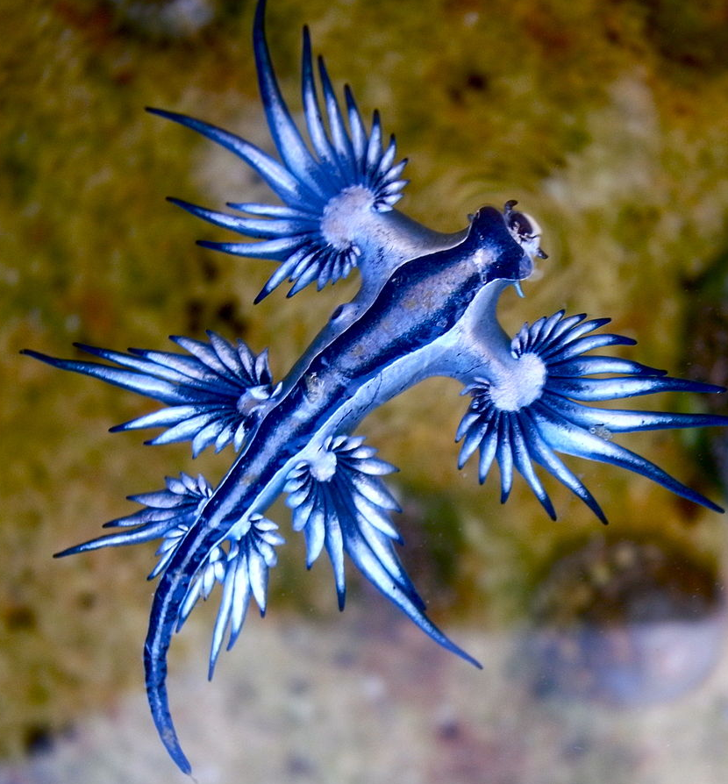
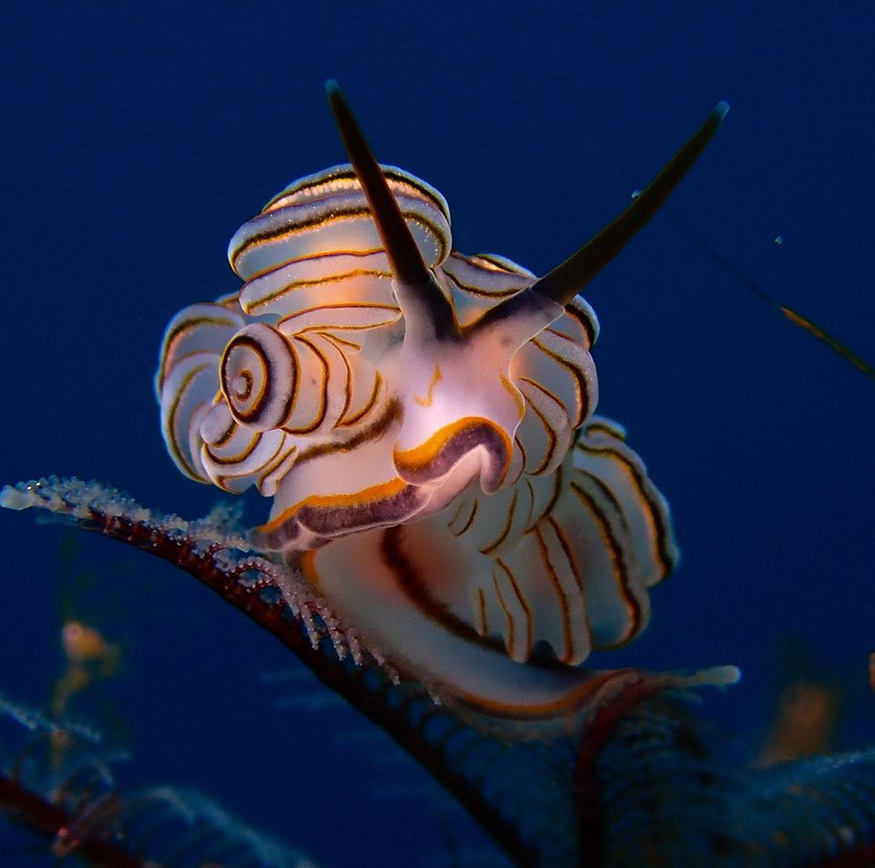
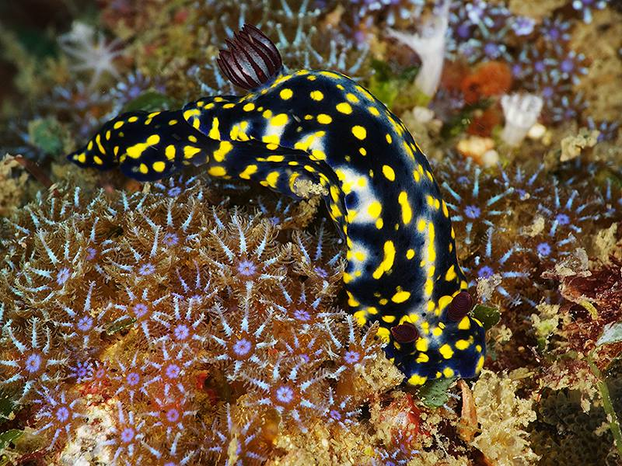
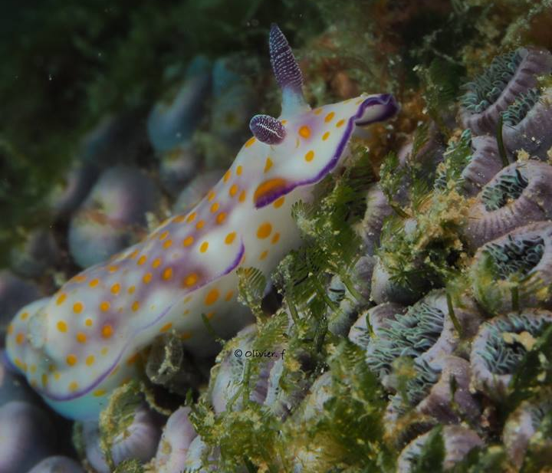
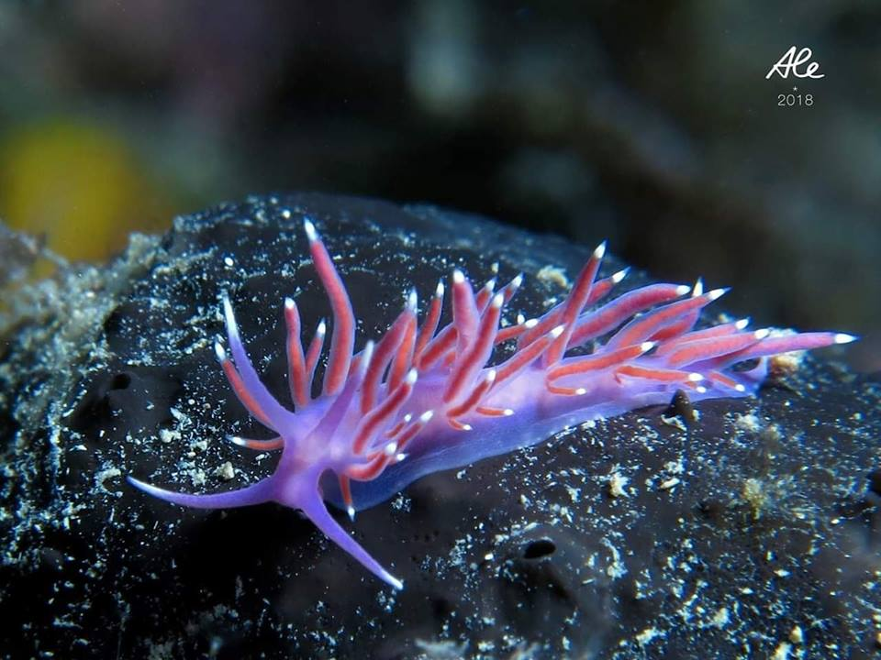
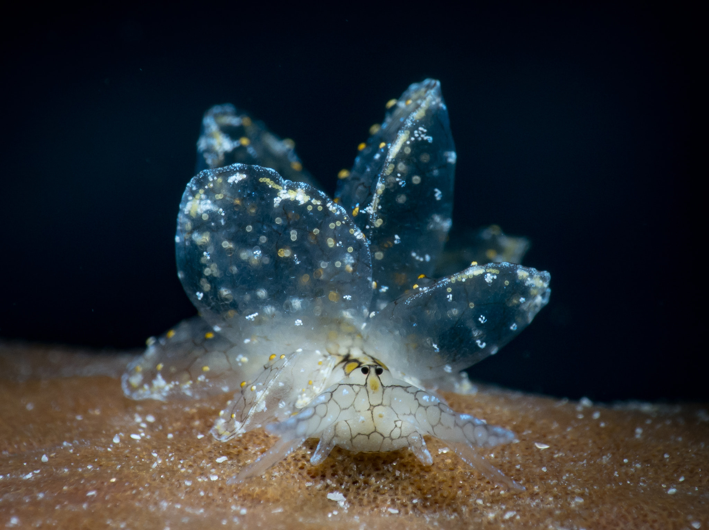
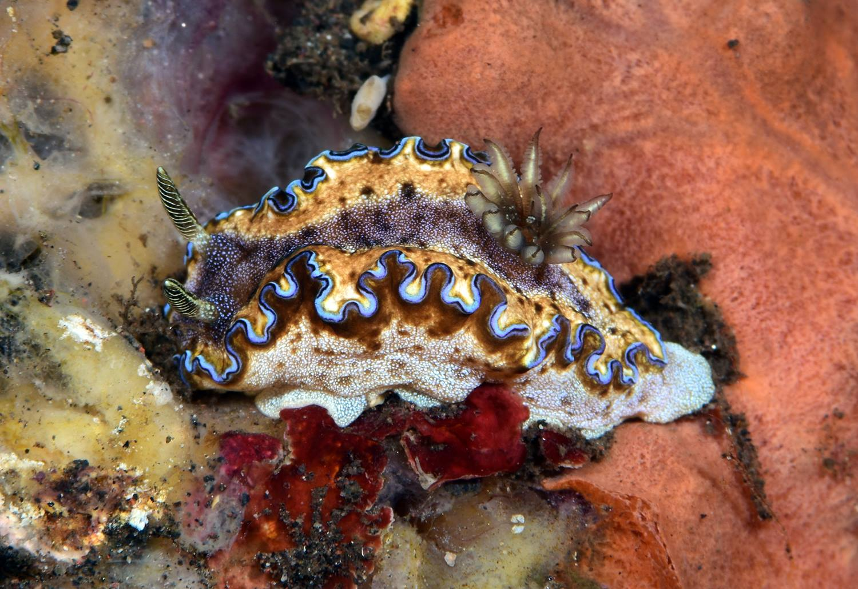

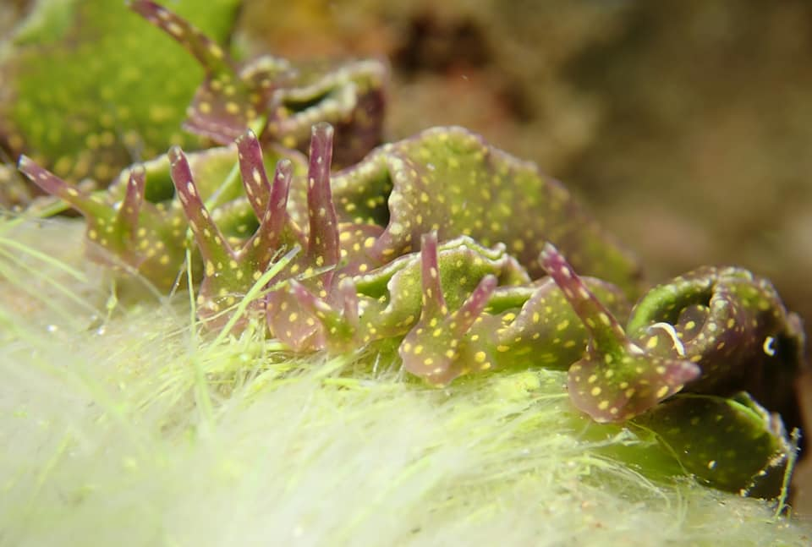
More nudes

